Slide 1
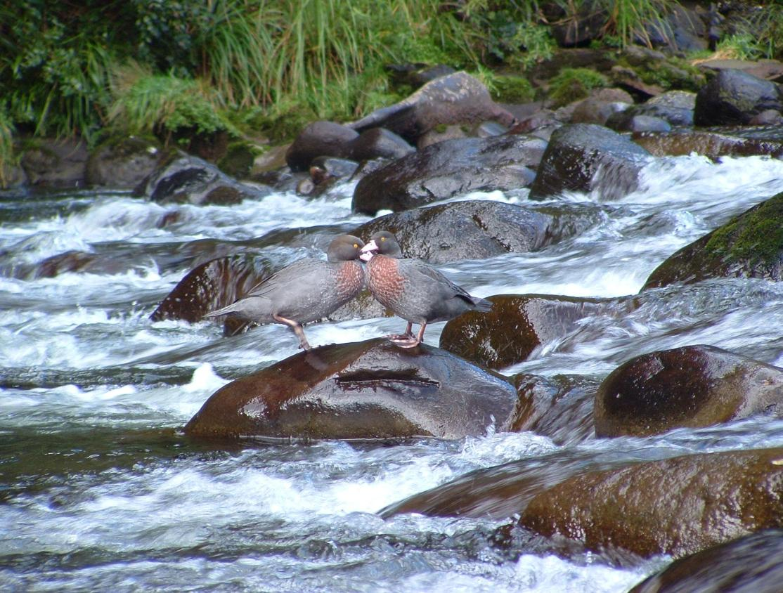
Whio
Blue duck
Photo: Bubs Smith

Slide 2
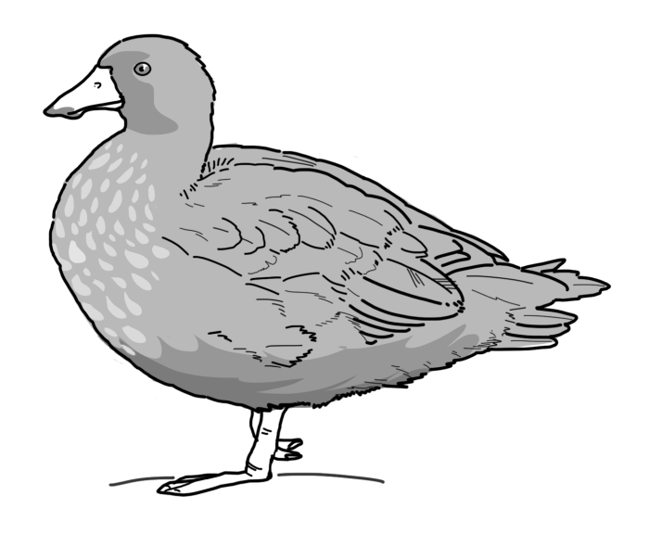
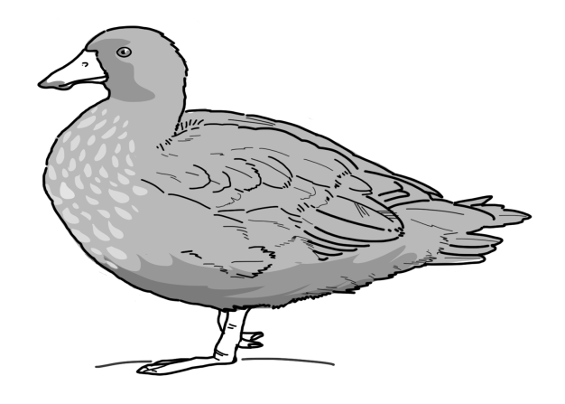
Meet the whio
“Before we start… What do you already know about whio?”
“Kia ora, I’m a whio.
Pleased to meet you!”
Notes:
Ask students to record their prior knowledge or brainstorm as a class what they already know about whio.

Slide 3
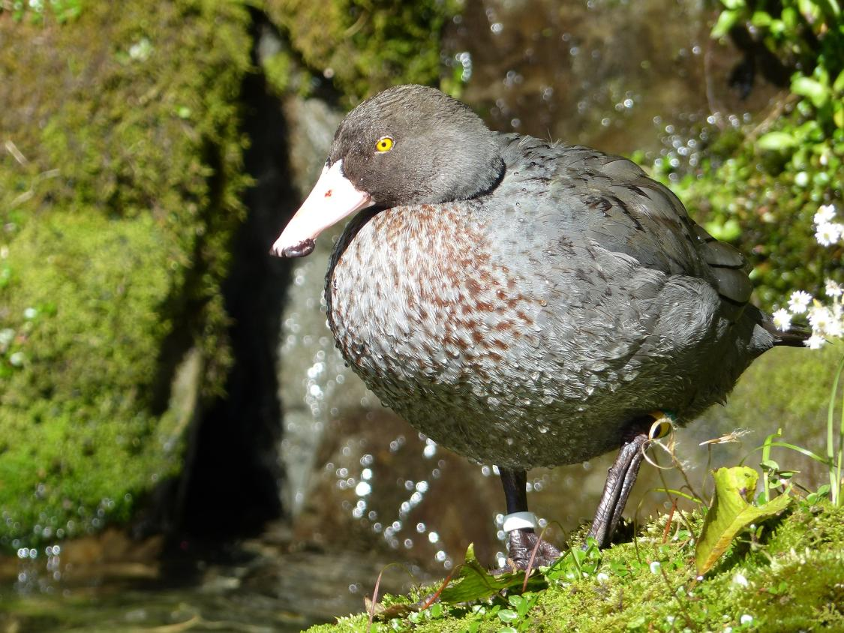
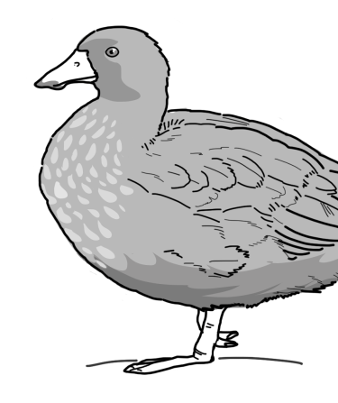
“Now, let’s learn more about these amazing birds!”
Photo: Bubs Smith
Notes:
The activities and learning experiences in this resource will help you to learn all about whio. WHI sounds like “FEE”. Pronounce the O in whio as in “OR” not as in “GO”. See https://www.youtube.com/watch?v=uoEKfVP1i6g for an example of how to pronounce Māori vowel sounds. Image: Bubs Smith

Slide 4
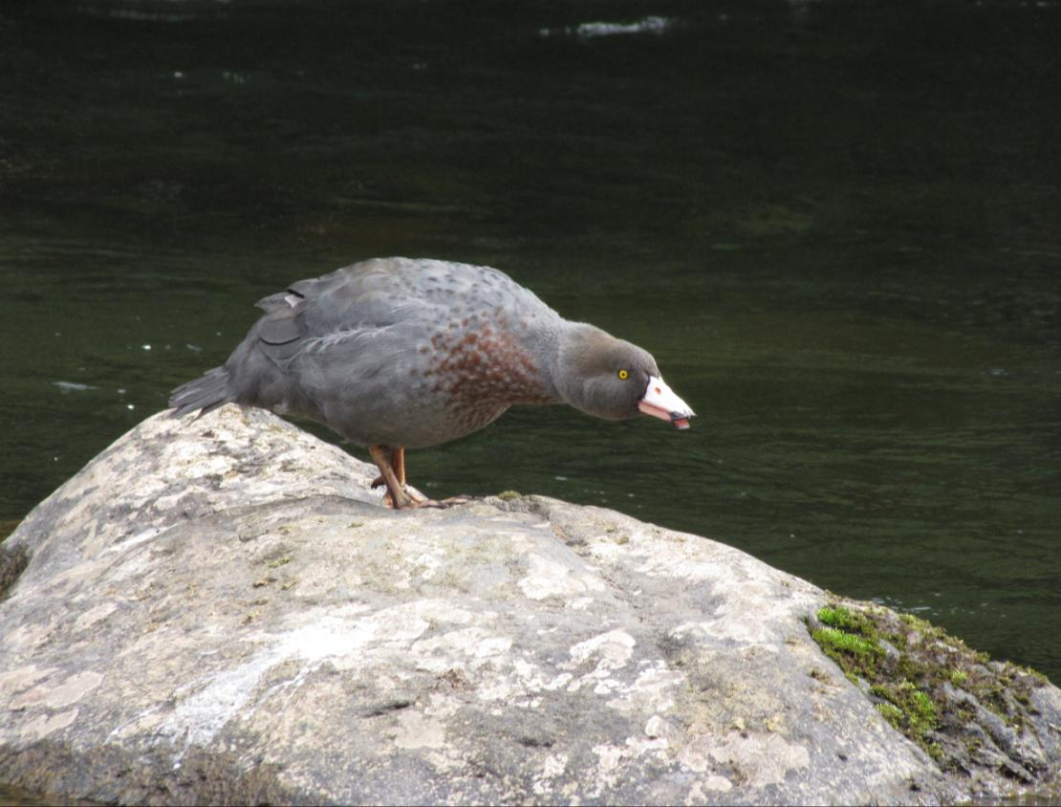
Whio are also known as blue ducks.
They are endemic- which means that they only live in
New Zealand.
Blue ducks belong
to the family of birds called Anatidae.
Photo: Bubs Smith
Notes:
Endemic means that they only live in New Zealand and nowhere else. A native animal can also be found in other countries but was originally found here.
Image: Bubs Smith

Slide 5
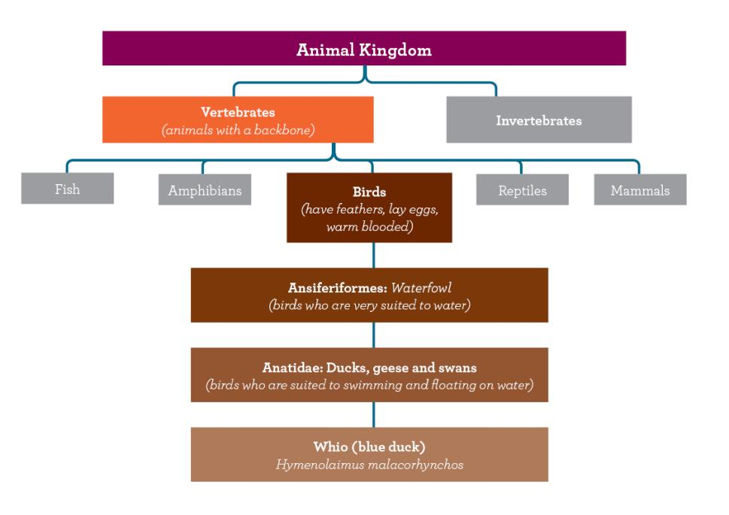
Whio scientific classification
Notes:
Whio are types of birds that are adapted to water: waterfowl. They are members of the family Anatidae which also includes other ducks, geese and swans.
Whio are the only living member of their genus: Hymenolaimus.

Slide 6
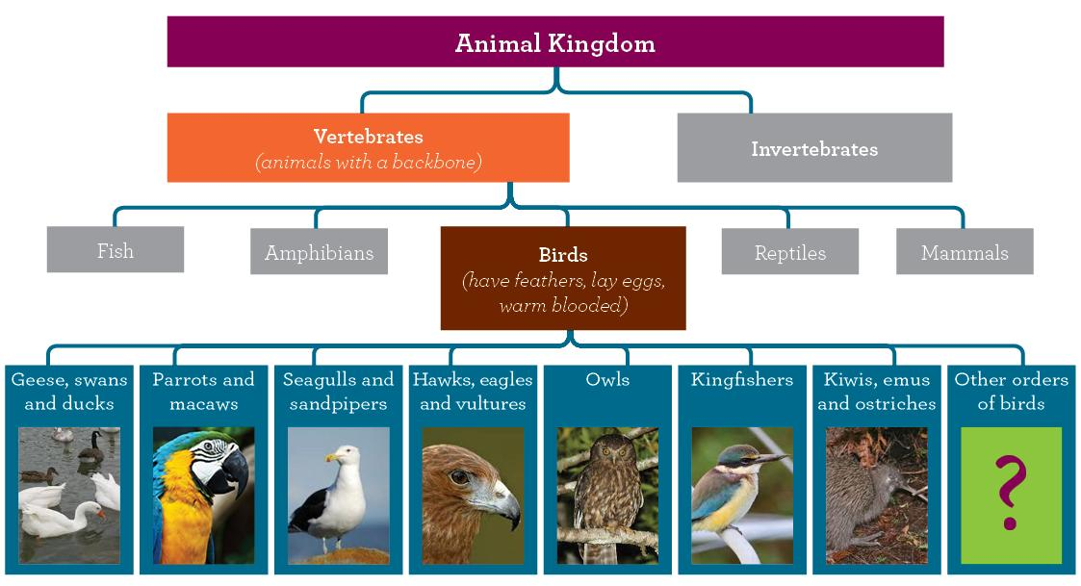
Types of birds

Slide 7
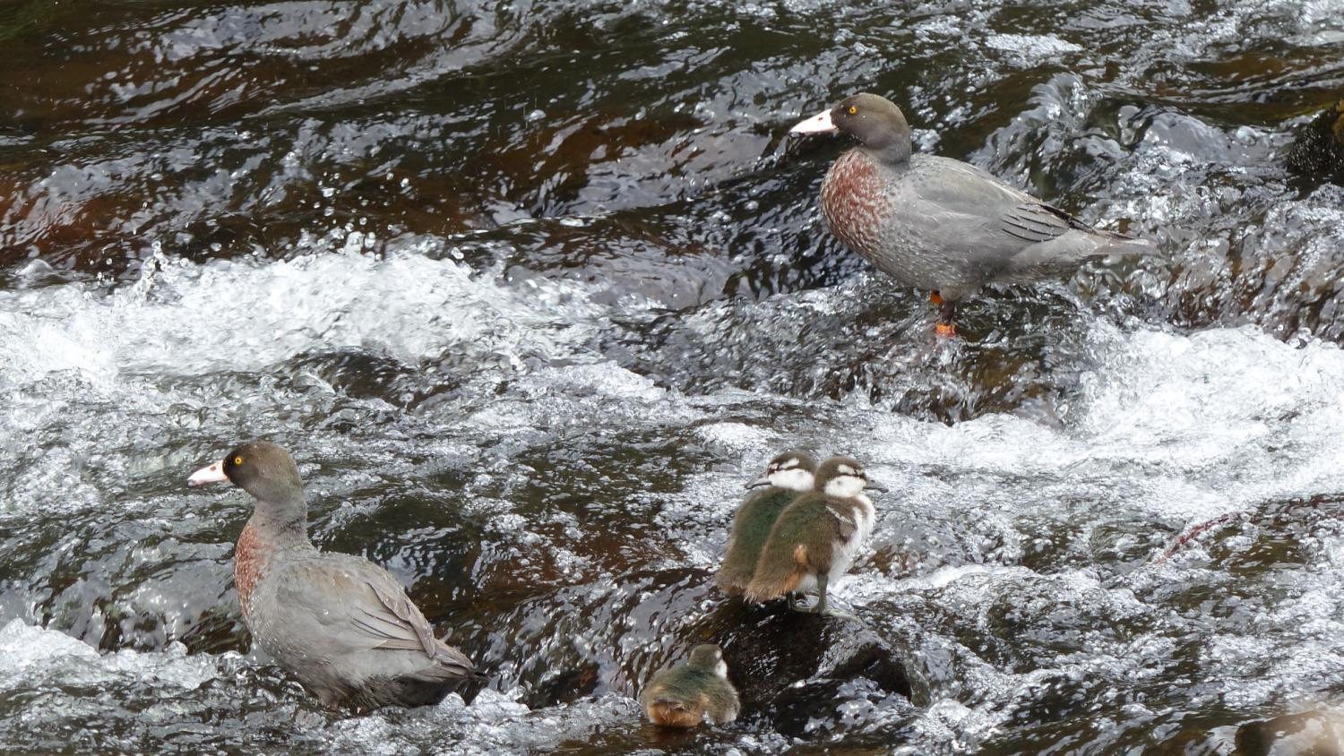
Blue ducks/whio live all
year round in fast-flowing rivers. That is very unusual for a duck!
Photo: Bubs Smith
Notes:
Whio are one of only four duck species worldwide who live throughout the year in fast flowing rivers.
Image: Bubs Smith

Slide 8
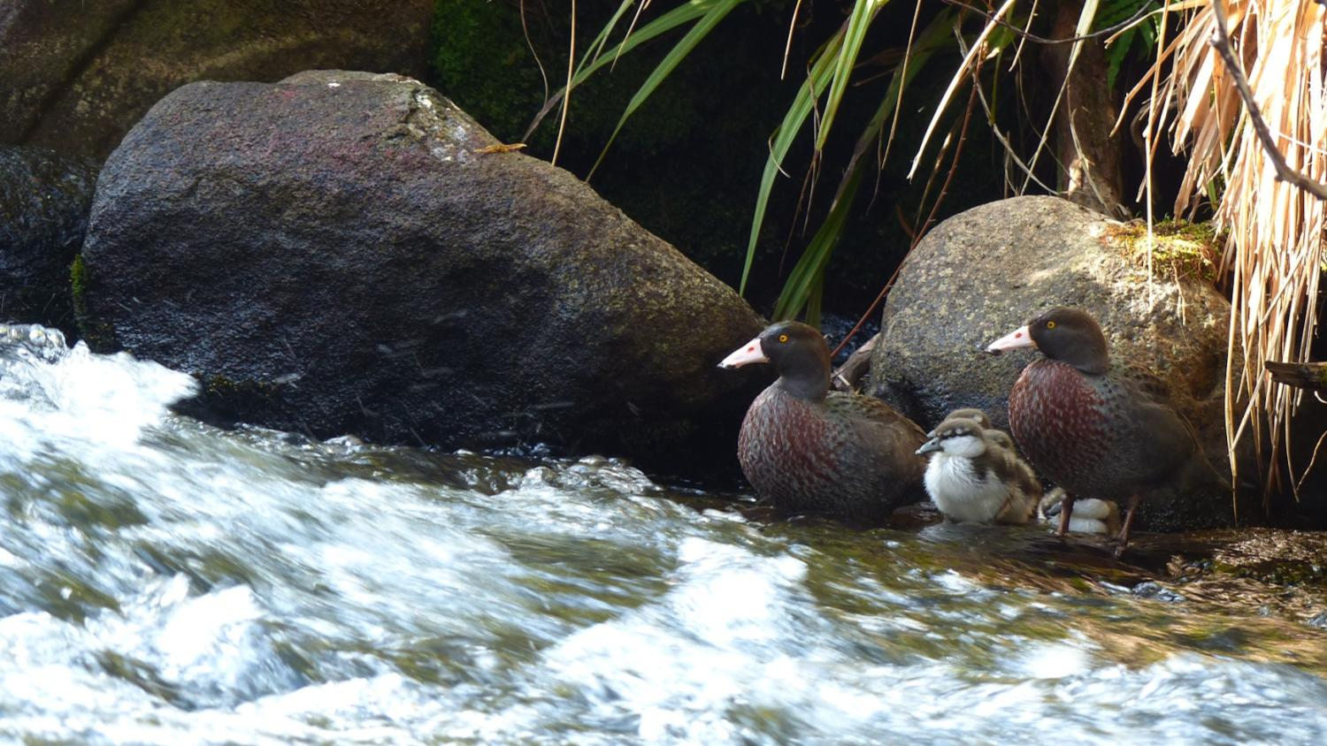
In Te Reo Maori, whio means whistle. The male whio make a whistling sound and the girls make a growling sound.
Click link for whio sounds
http://podcast.radionz.co.nz/birds/birds-20140708-0700-whio-048.mp3
Photo: Bubs Smith

Slide 9
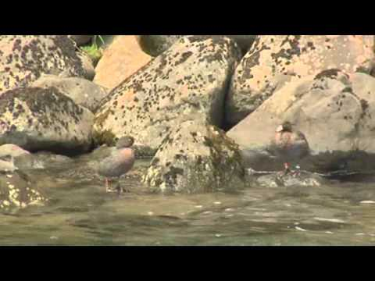
Notes:
Meet the locals whio video

Slide 10
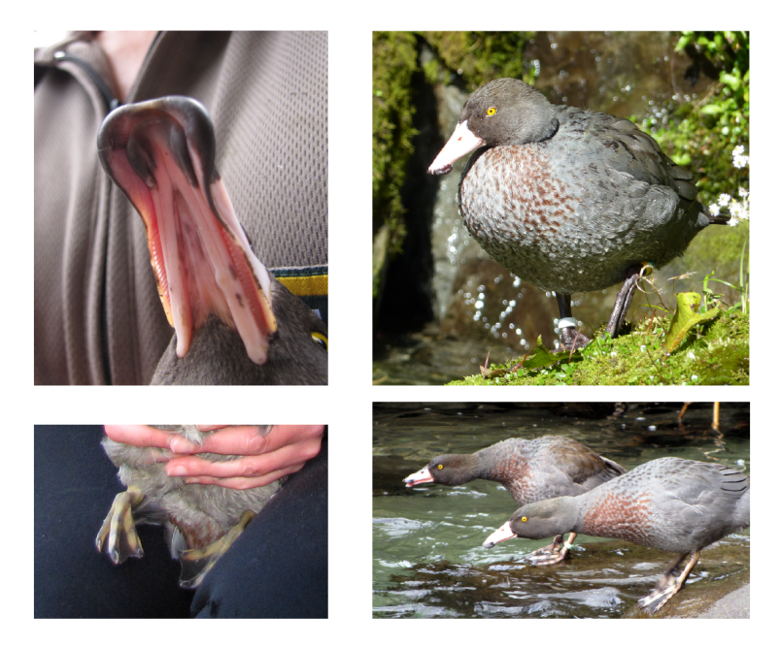
Whio special features
Waterproof
feathers
Bill
With rubbery
lips to withstand feeding off rocks
Webbed feet
That open
and close like
an umbrella
Streamlined body
Designed to glide
through the water
Photos: Bubs Smith

Slide 11
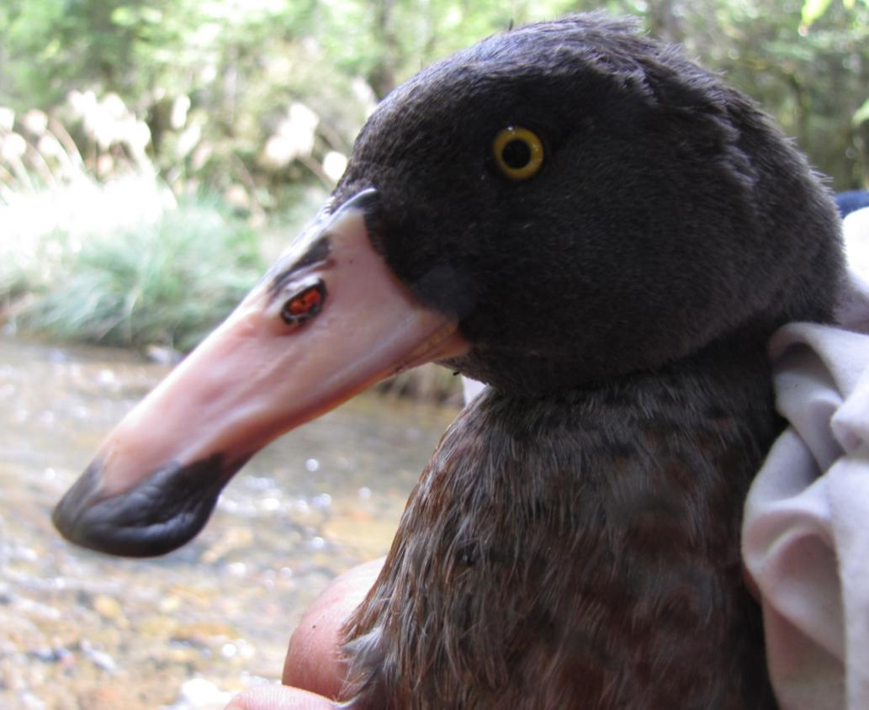
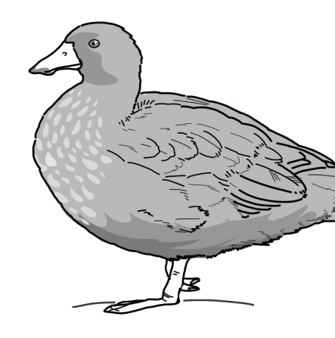
Their special features help whio to survive in a fast-flowing river habitat.
“We’ll learn more about these in the next activities”
Photo: Bubs Smith

Slide 12
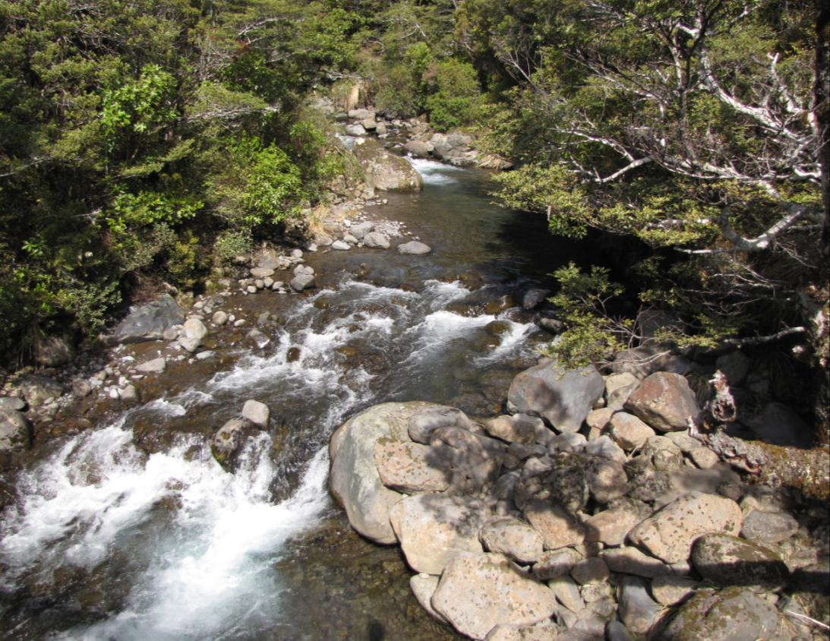
Whio habitat
Whio live only in high quality, fast-flowing rivers.
They need rocky rivers lined with plants and trees.
Photo: Bubs Smith

Slide 13
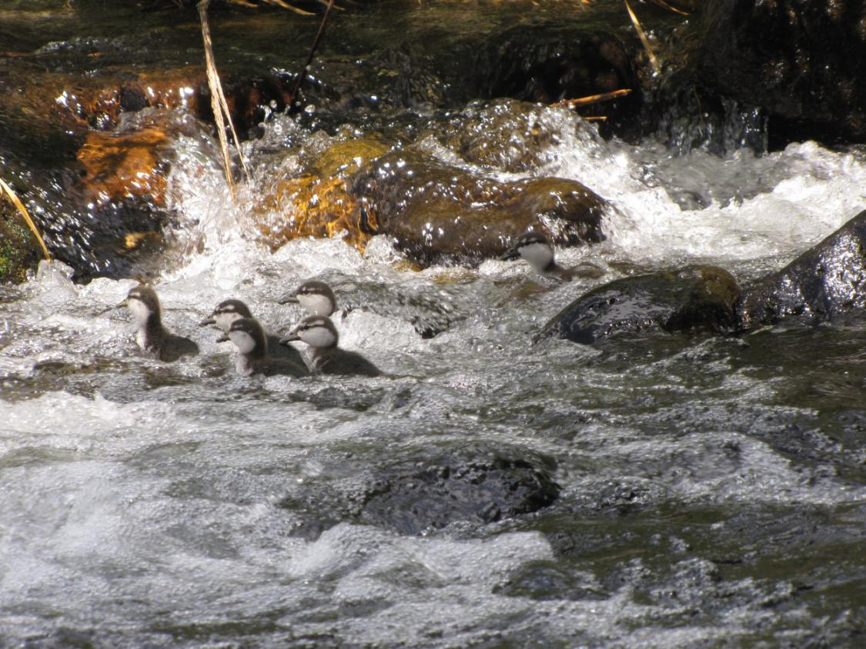
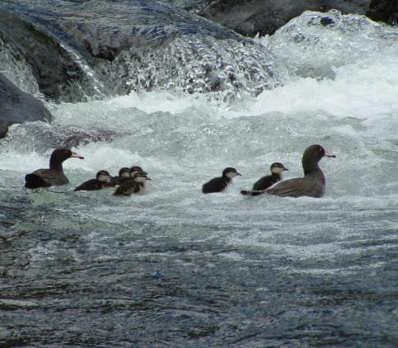
“Surf’s up dudes!”
“Whio love to surf
the rapids- even when we are chicks!”
Photo: Bubs Smith

Slide 14
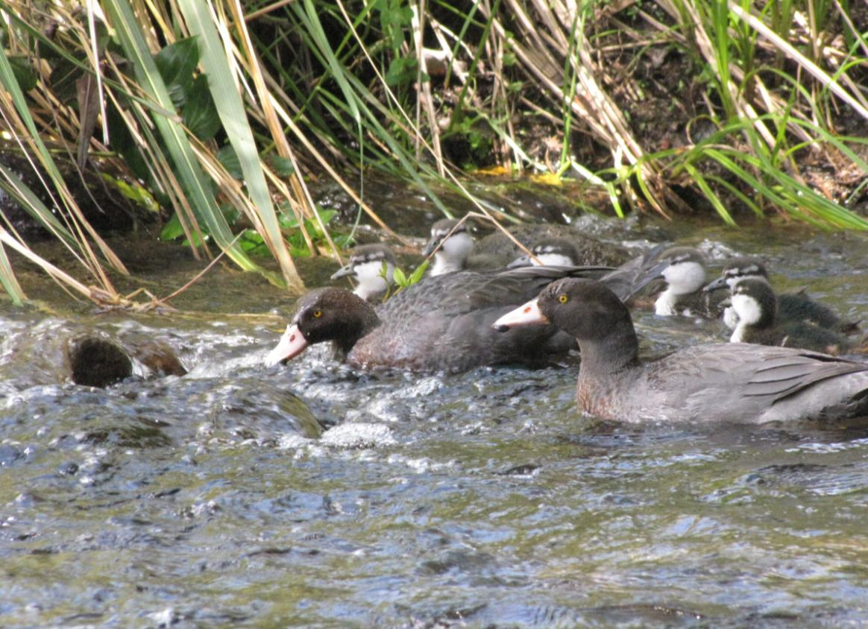
Whio families
Whio usually
have between
4-6 chicks.
Both parents have to look after the
chicks to keep them safe on the river.
Photo: Bubs Smith

Slide 15
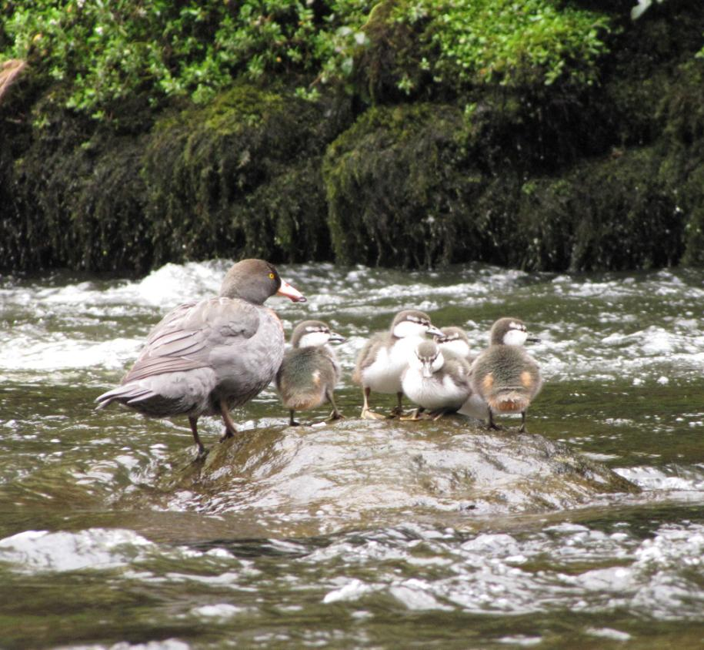
Threats
Before people came to
New Zealand whio had
few threats, but now they
are endangered.
Introduced pests such as stoats, rats, dogs and feral cats threaten the survival of whio. Humans also threaten their habitat when we change how we use the land around rivers.
There are approximately
3000 whio left in the wild.
Photo: Bubs Smith

Slide 16
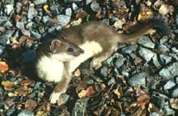
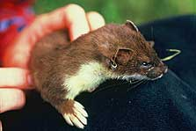
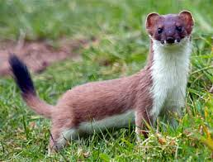
Stoats are the whio’s biggest threat. They kill nesting females and ducklings. These cute killers are excellent swimmers and will take whio eggs.
Stoats also kill other New Zealand birds.
“I’m a stoat- one of the whio’s biggest threats”
Notes:
These images are from DOC website http://www.doc.govt.nz/nature/pests-and-threats/animal-pests/animal-pests-a-z/stoats/

Slide 17
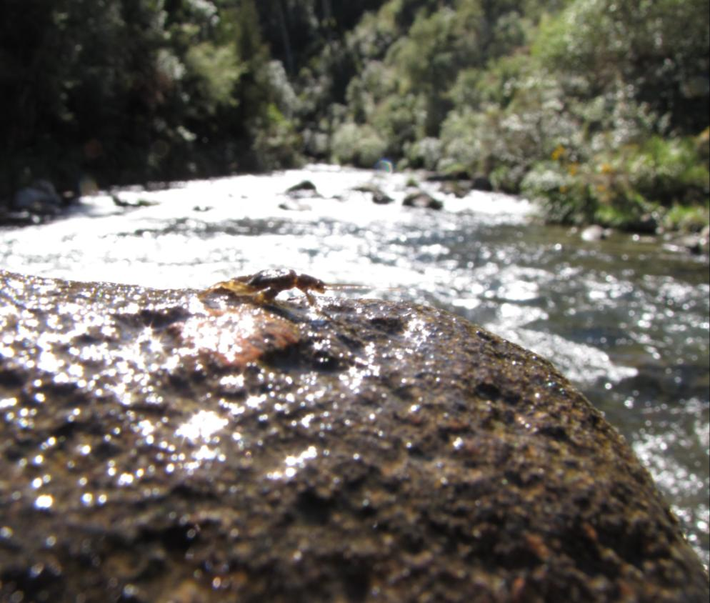
If whio are living in a river, we can tell that it is a very healthy river with plenty of life and extremely clean water.
Whio depend on insect larvae like this mayfly for food. These larvae only live in healthy streams and rivers.
Photo: Bubs Smith
Notes:
This is a mayfly larva on a rock. Mayfly and stonefly larvae are sensitive to pollution and usually only live in clean, shaded, forested rivers. Whio eat these larvae and the algae and biofilm from the rocks. So if whio are around it means there are plenty of these larvae and it is a sign that the river is of very high quality. This makes whio an ‘indicator species’.

Slide 18
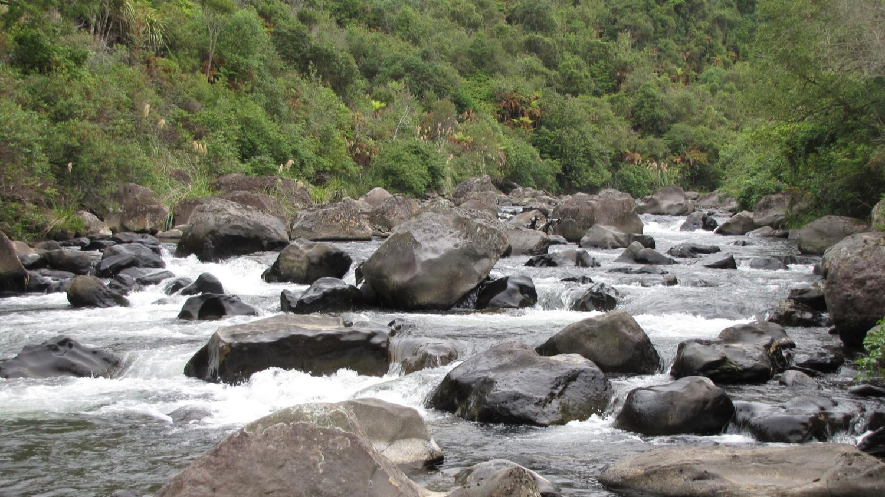
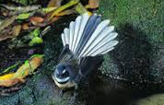
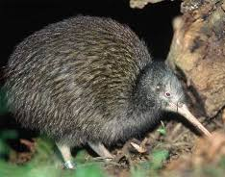
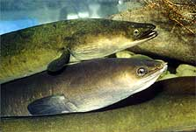
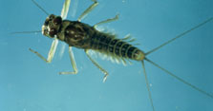
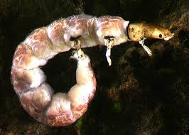
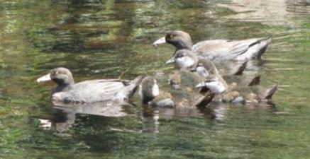

Everything is connected!
Whio are part of a whole ecosystem and have many connections to other animals and the environment
Background photo: Bubs Smith
Notes:
It’s all connected! The ecosystem is a complex set of interactions between animals, plants and the environment. (From kiwi clockwise: eels, banded kokopu, whio, caddisfly larva, mayfly larva, fantail). The health of forest animals such as kiwi and fantails are also connected to the health of the river- every animal needs healthy water to survive and some (like the fantail) rely on insects for food that start life in streams. Images from DOC website

Slide 19
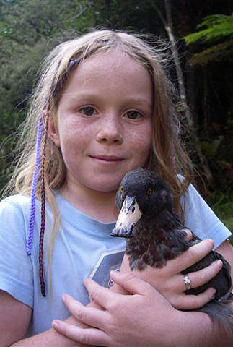
Whio forever
We can all help to keep whio in our rivers forever
“What would you like to find out next about whio?”
Notes:
Ask students to think about what they would like to know next about whio. Has the presentation raised any questions? Record the questions to guide the next stage of the learning inquiry. IMAGE of girl and whio from doc blog- http://blog.doc.govt.nz/2013/04/05/jobs-at-doc-whiona-mother-duck/

