Slide 1
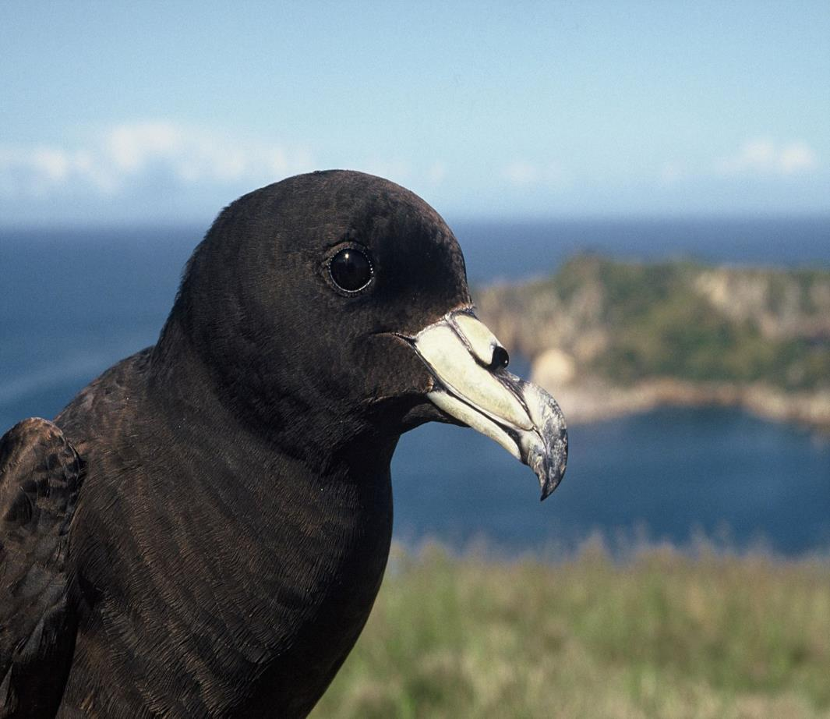
Black Petrels/ Tāiko Procellaria parkinsoni
Photo Credit: Terry Greene, DOC
Notes:
This slideshow is about black petrels (Tāiko in Māori). They can also be called ‘Parkinson’s petrels’ after Bank’s artist –(Sydney Parkinson)
on Captain Cook’s first voyage to NZ, http://nzbirdsonline.org.nz/species/black-petrel#bird-sounds

Slide 2
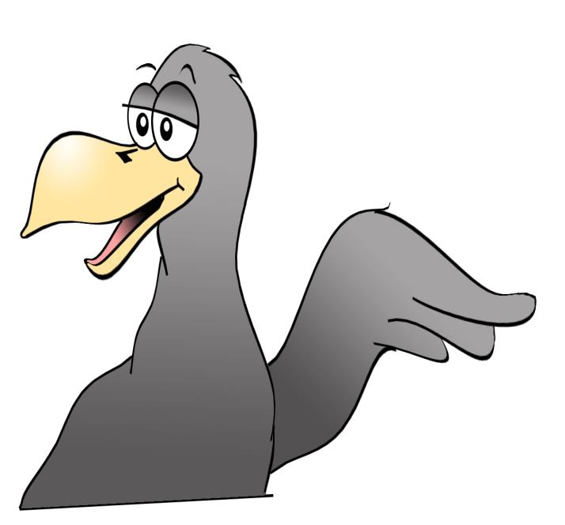
What do you already know about us?
Notes:
Discuss what students already know about this bird. Share any experiences of Black Petrel/ Tāiko.

Slide 3
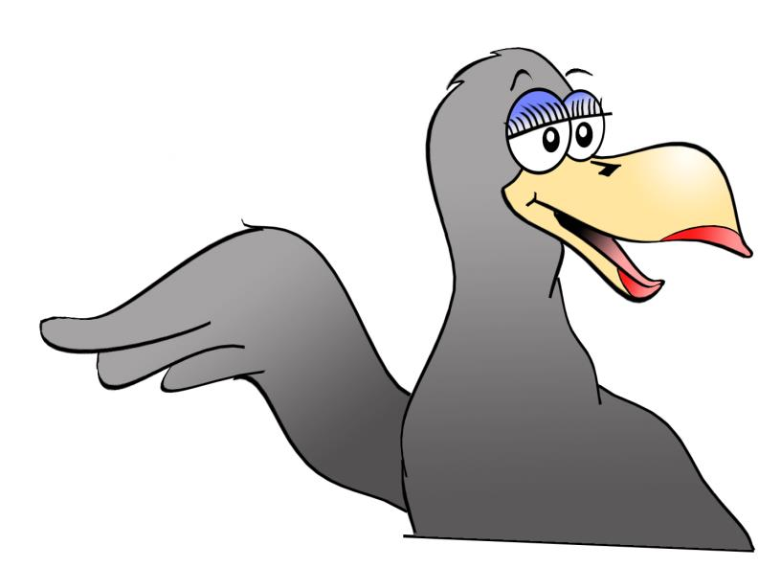

We are seabirds!
Notes:
Black petrels are one of our taonga (treasures) of the Hauraki Gulf. They are one of the most threatened seabird species and now only breed on two offshore islands in Northern NZ

Slide 4
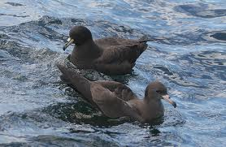
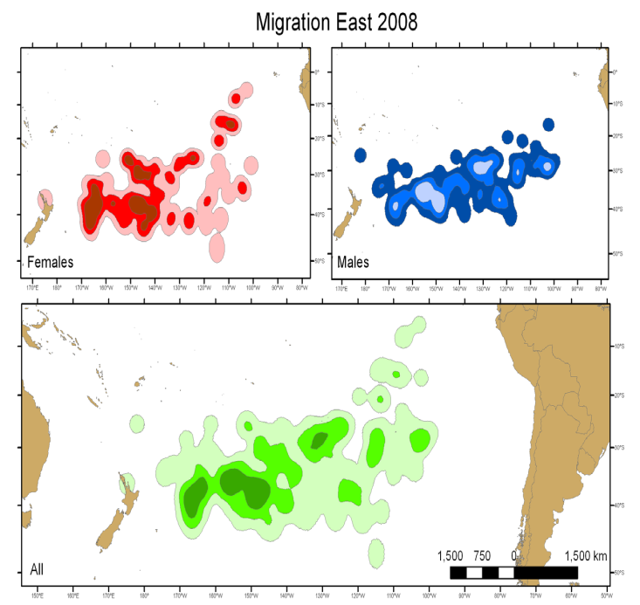
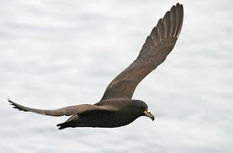
We spend most of our lives at sea
Notes:
Seabirds like the black petrels/ tāiko spend most of their lives at sea. The green blobs on the lower image are black petrels on their journey between NZ and South America.

Slide 5
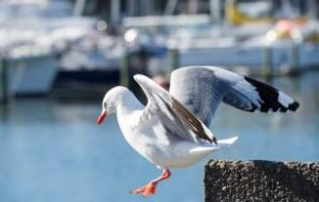
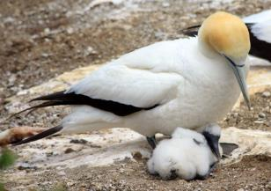
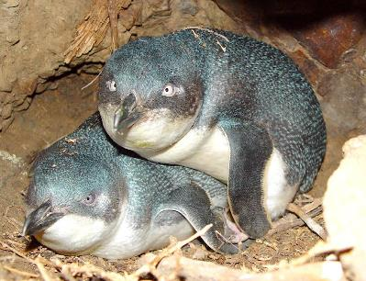
What do you notice about these seabirds?
Notes:
Seabirds can look very different to each other but they have some similarities. Most have large wings for flying long distances, waterproof feathers and streamlined bodies for diving. Penguins are exceptions as they have adapted for living almost always at sea and fly through the water. Images: Red- billed gull (top left), Australasian gannet (top right), little blue penguin (bottom left) and black petrel/tāiko
(Photos from http://blog.doc.govt.nz/tag/seabirds/ and doc website)

Slide 6
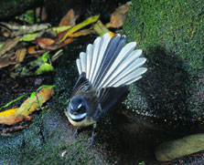
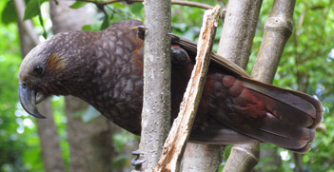
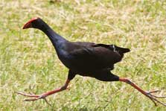
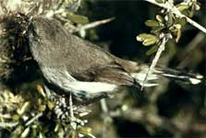
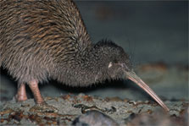
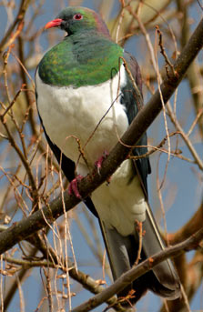
How are seabirds different to birds that live on land?
Notes:
Birds who live on land are also suited to their environment. They are generally not as good fliers as seabirds and do not have waterproof feathers or streamlined bodies. From top left to bottom right: fantail, kaka, pukeko,grey warbler, kiwi, kereru/kukupa/ NZ wood pigeon

Slide 7
Migration
Black petrels migrate from New Zealand to South America for the winter
They have to survive for weeks at a time at sea
Notes:
Migration: what is this? Why do birds and other animals migrate? Migration is the regular movement of groups of animals from one region to another, usually for feeding, warmth or breeding.
Animals migrate for many reasons, including avoiding food shortages in different seasons, dodging extreme weather conditions and to follow resources such as water. New Zealand seabirds probably migrate to avoid our relatively harsh, cold winter. Migration takes a lot of effort but increases the chances of a seabird surviving. Not all seabirds migrate.

Slide 8
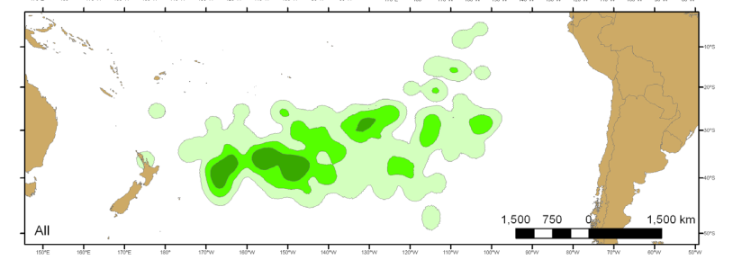
Breeding
Black petrels fly back from South America
to Northern New Zealand to breed
Notes:
Black petrels fly from South America to New Zealand in late October for the breeding season (a journey of over 11000 km). What is breeding? – (Raising their young)

Slide 9


I find a mate in spring and make a burrow
Notes:
They pair up with their partner and depart for a short honeymoon period, before returning in late Oct/November to lay a single egg.

Slide 10
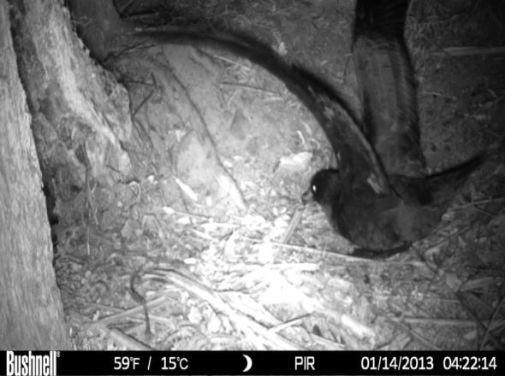
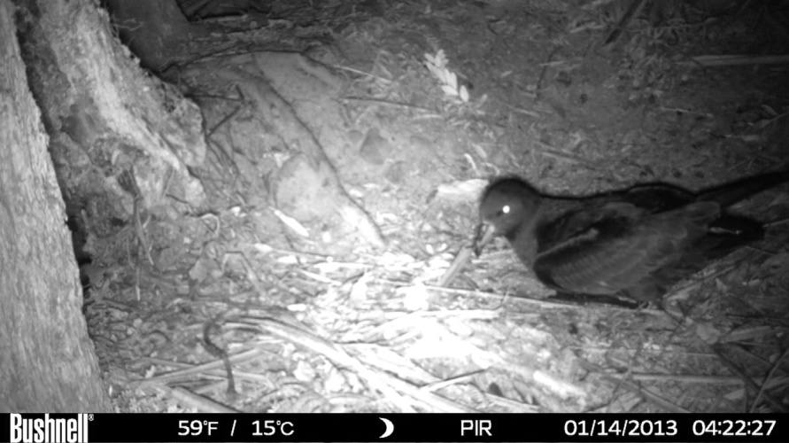
Notes:
Birds breed only in forested areas, so must crash through the canopy to locate their burrow and prepare it for breeding.

Slide 11
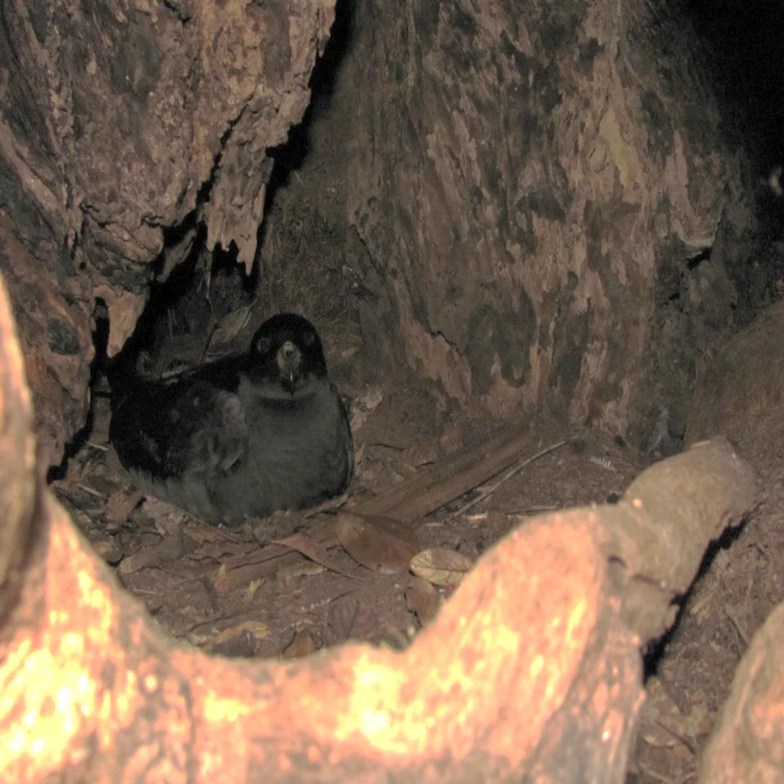
Notes:
The birds make burrows in trees or in the forest floor. They use the burrows to lay their eggs and raise their chick. This is a real black petrel sound recorded in a breeding area.

Slide 12
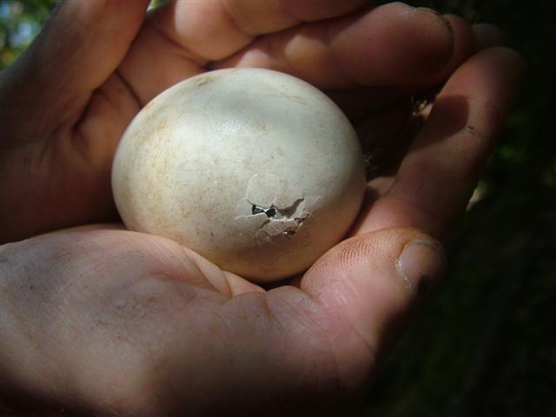
What
Here I come!
Notes:
The egg is incubated by both parents, and may sit by itself for several days yet still remain alive during the first few weeks. Chicks hatch after 2 months-in late January -February.

Slide 13
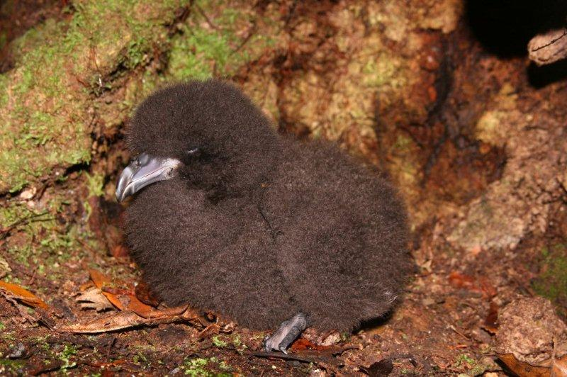
Notes:
A petrel chick! A parent stays with the chick for the first week, then the chick may be left while parents are off finding food.

Slide 14
It takes 107 days (3.5 months!) of feeding and growing until chicks are ready to fledge (leave the burrow)

Slide 15

What
I’m pretty special!
I only breed in New Zealand!

Slide 16
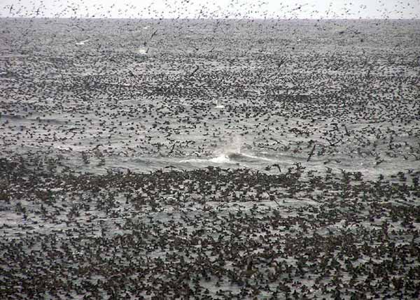

Notes:
This is the sight and sound you are likely to have heard along much of NZ’s coastline about 800 years ago. Gannets, penguins, shags, petrels, albatrosses, terns and skua were common…
Black petrels could be found throughout the North Island and in parts of the top of the South Island.

Slide 17
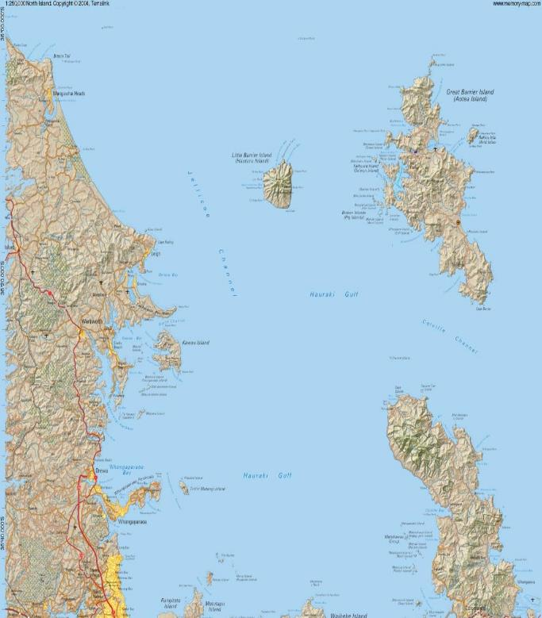
125 pairs
1500
pairs
Notes:
Now, the only known breeding locations for black petrels are Great Barrier Island on Hirakimata – the stronghold with 1500 pairs, and a few other locations in Great Barrier Island, and Little Barrier Island with an estimated 250 birds
The global population is estimated at 10-15000 birds including 6000 juveniles at sea.
They are a threatened species that is listed as Vulnerable internationally.

Slide 18

What
What do you know about black petrels now?
Notes:
Encourage students to discuss or record their learning from this activity

Slide 19
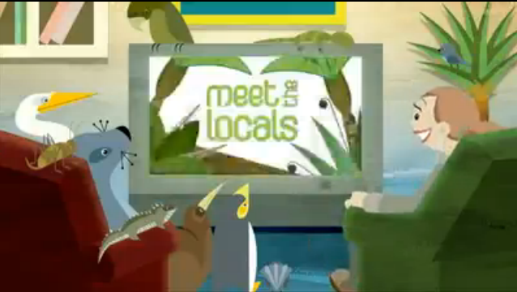
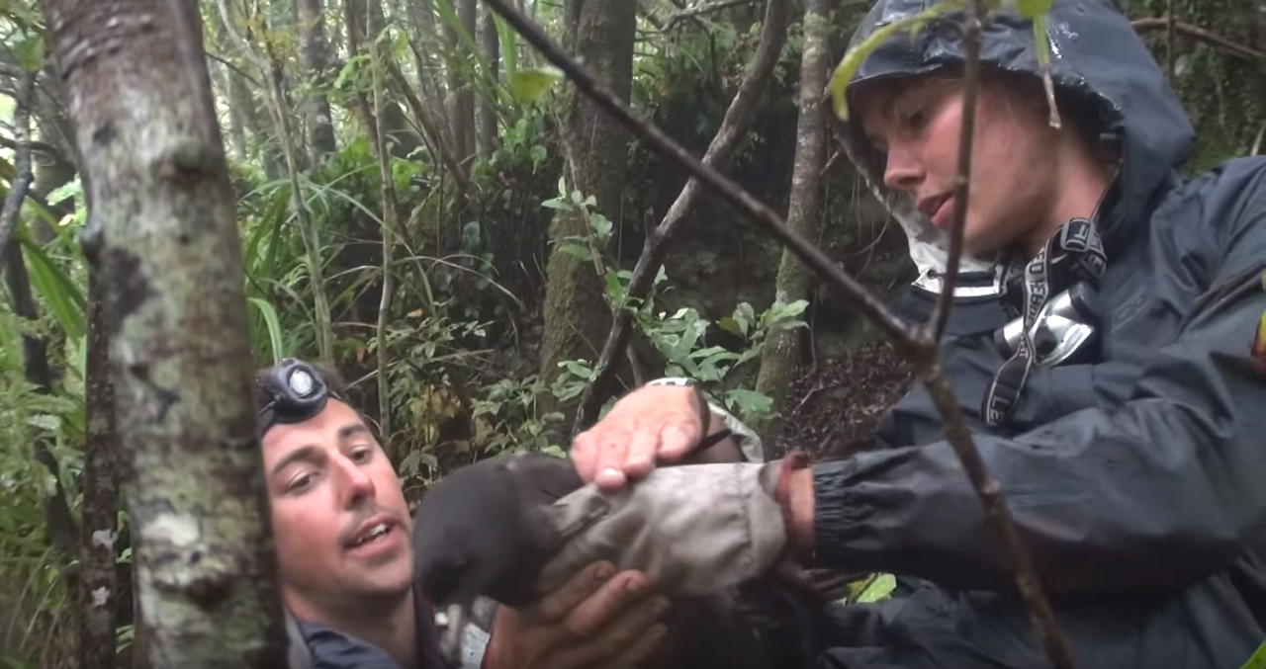
Activity Two resources
Meet the Locals
Notes:
Two different video clips
Meet the locals video – click to play and link with website
Black Petrels of Great Barrier Island – you tube clip produced for advocacy work by a volunteer film producer. – click to play and link with website

Slide 20
What
What are some of my special features?
Notes:
Adults are specially adapted to live at sea. What special features a do these birds have to live the way they do? Consider how they feed, what they eat and drink, where they spend most of their time, how they keep waterproof and warm, and where they travel to). Examine taxidermy specimen and bones. Allow students to measure the length of wings and the birds body.
Petrels have;
Short legs and webbed feet – act like oars and paddles to move them efficiently through water
Strong sharp beak for catching prey
Long wings relative to their body length – optimise flying long distances
Light yet strong bones – minimise weight, yet be able to withstand diving pressures
Tube nose – petrels only drink salt water, so must concentrate the salt, then sneeze it out through their tubular nose holes. Other seabirds have salt glands above the eye sockets to remove salt.
Waterproof feathers – The preen gland provides waterproofing for feathers.
Layered feathers – to stay warm
Dark colouration – feeding at night
Good sense of smell and sight – to catch prey and sense danger

Slide 21
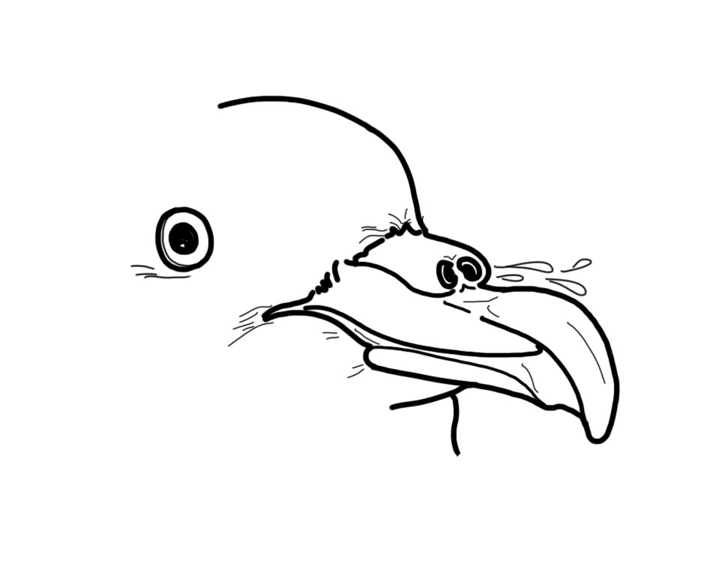
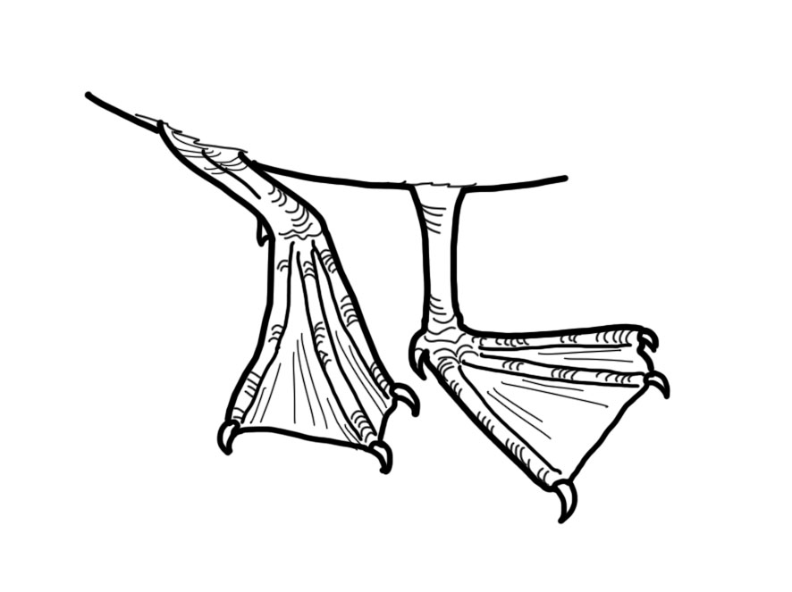
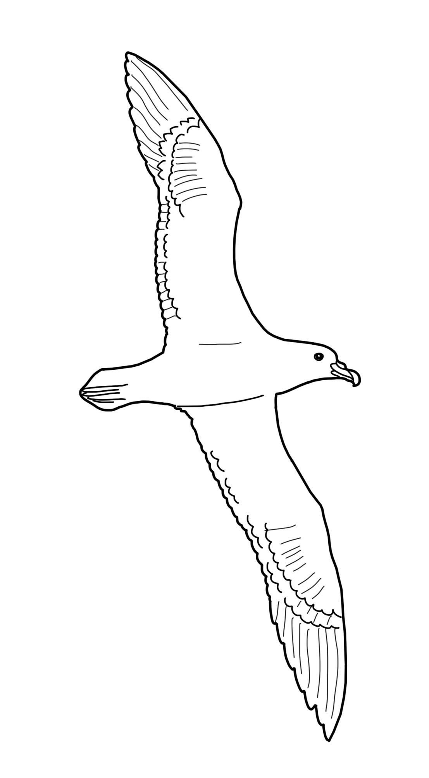
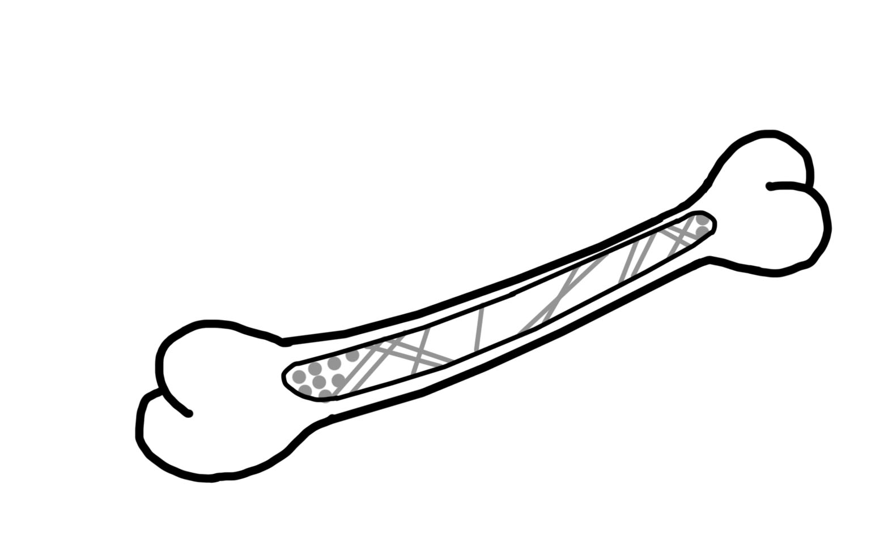
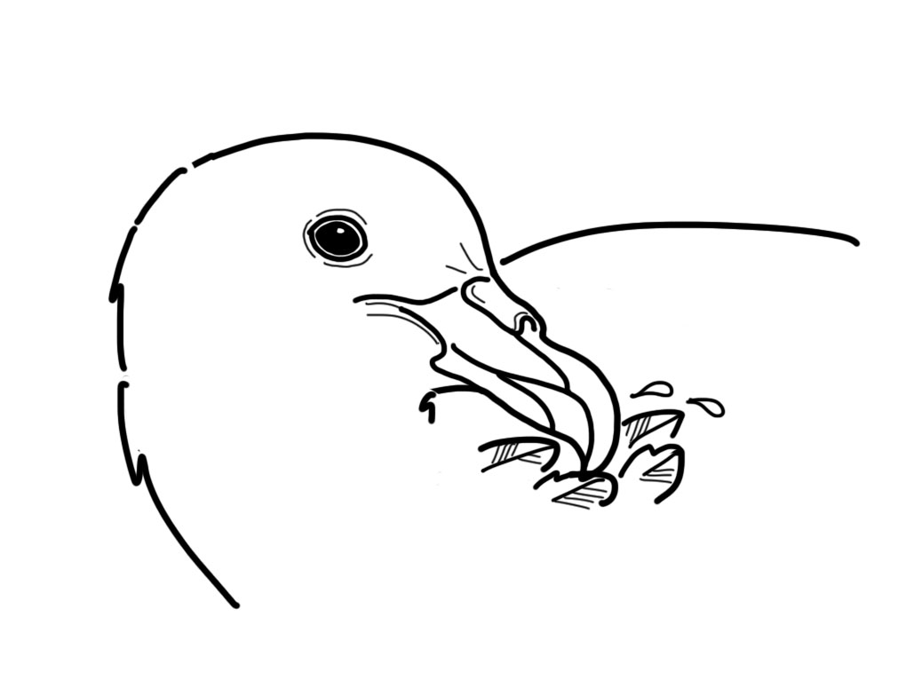

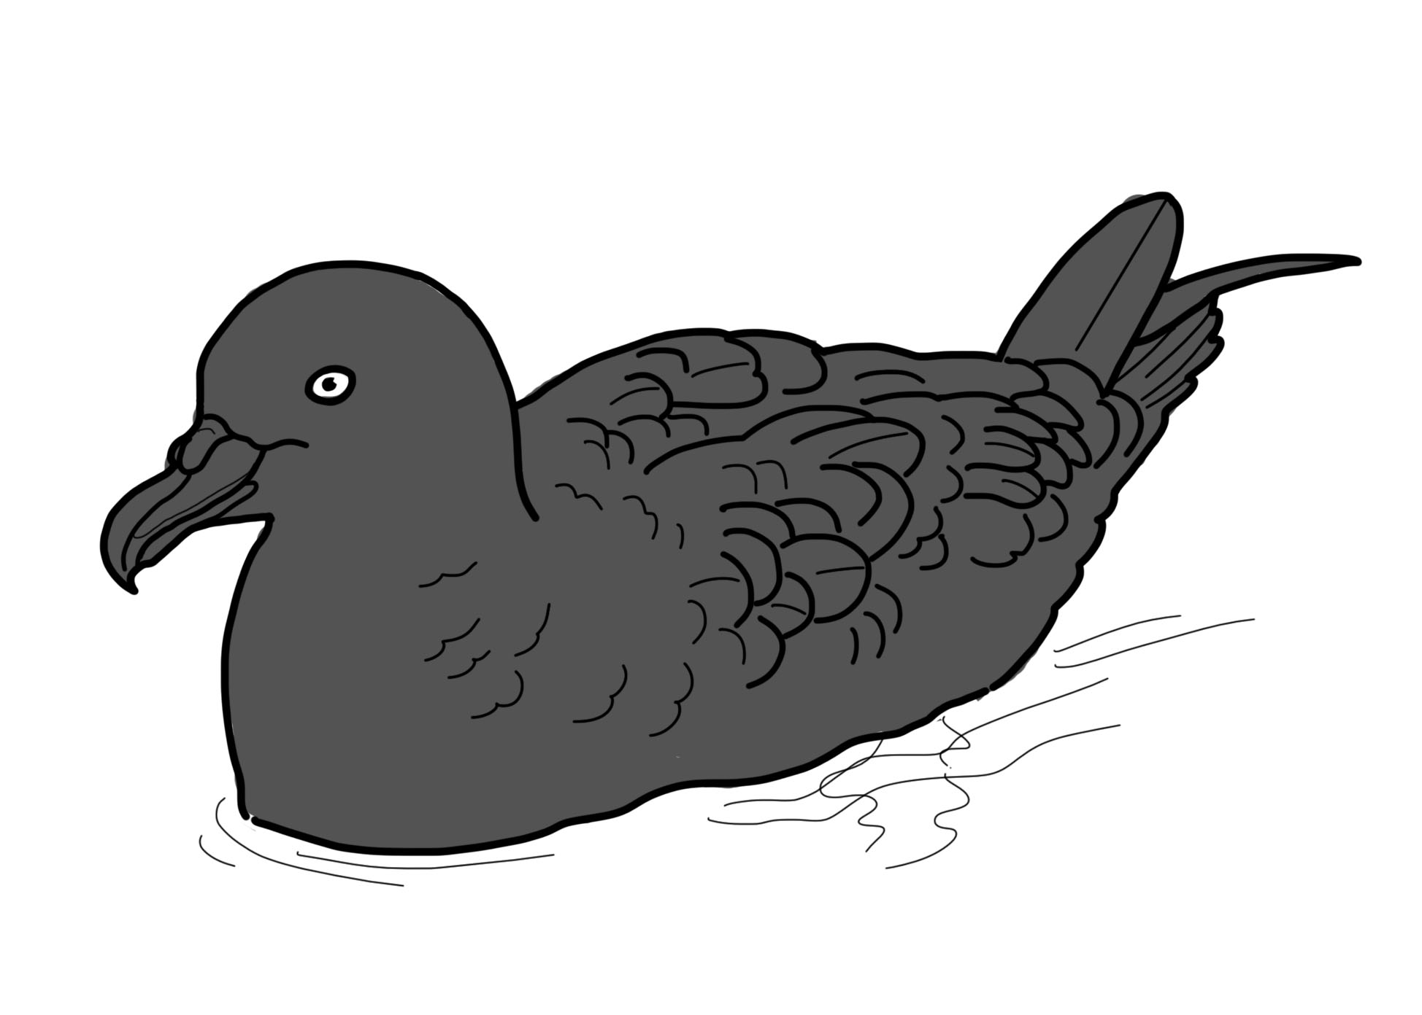
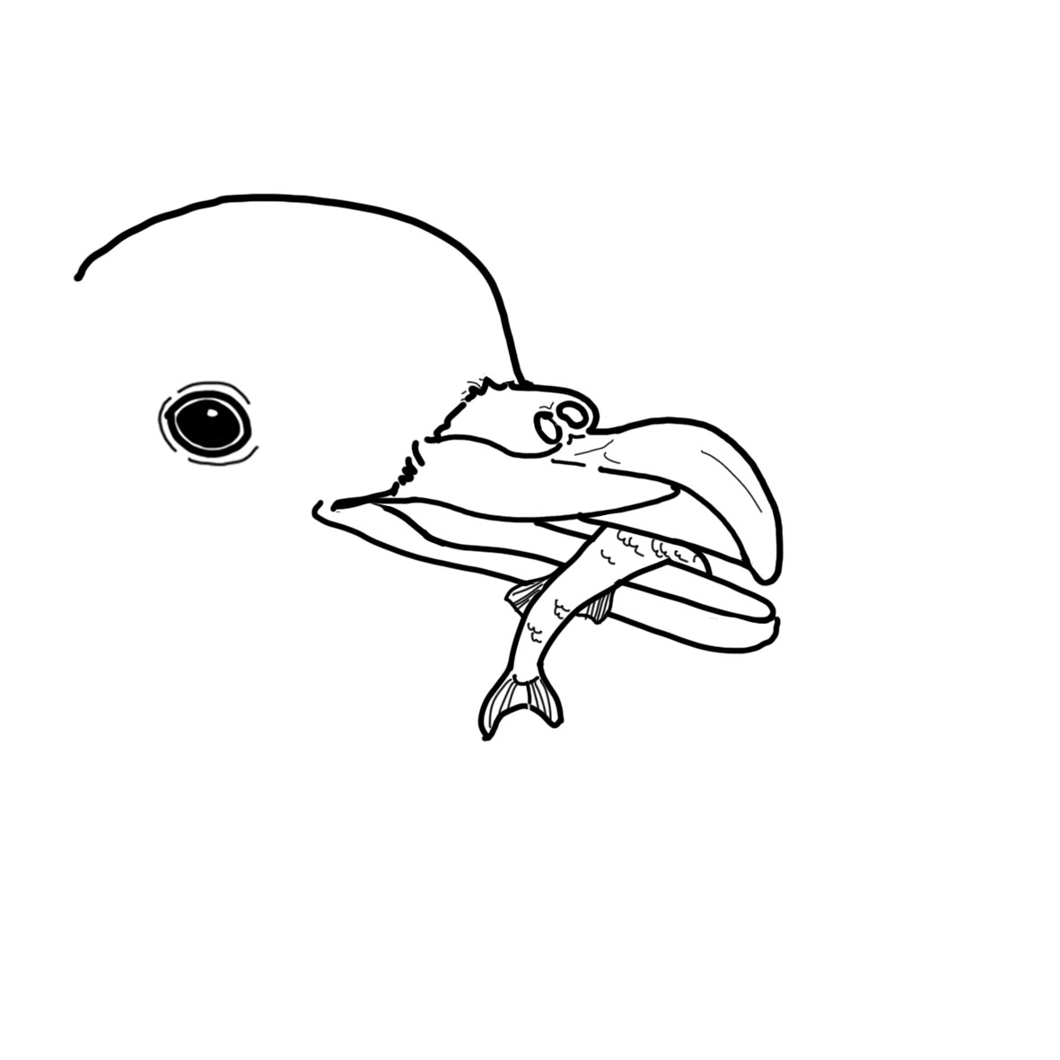

Notes:
• Short legs and webbed feet – act like oars and paddles to move them efficiently through water.
• Strong sharp beak – for catching prey.
• Long wings relative to their body length – optimise flying long distances.
• Light yet strong bones – minimise weight, yet enable them to withstand diving pressures of up to 27 m depth.
• Tube nose – petrels only drink salt water, so must concentrate the salt, then sneeze it out through their tubular nose holes (other seabirds have salt glands above the eye sockets to remove salt).
• Excellent sense of smell (olfactory sense) and sight – to locate colony
and burrow location, catch prey and sense danger.
• Waterproof feathers – the preen gland provides waterproofing for feathers.
• Layered feathers – to stay warm.
Dark colouration – for camouflaged feeding at night.
• Navigation – internal ‘compass’ to provide navigation.

