Slide 1

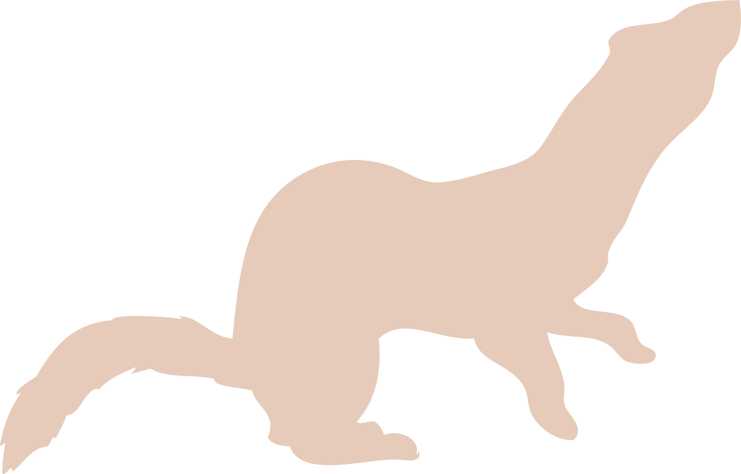
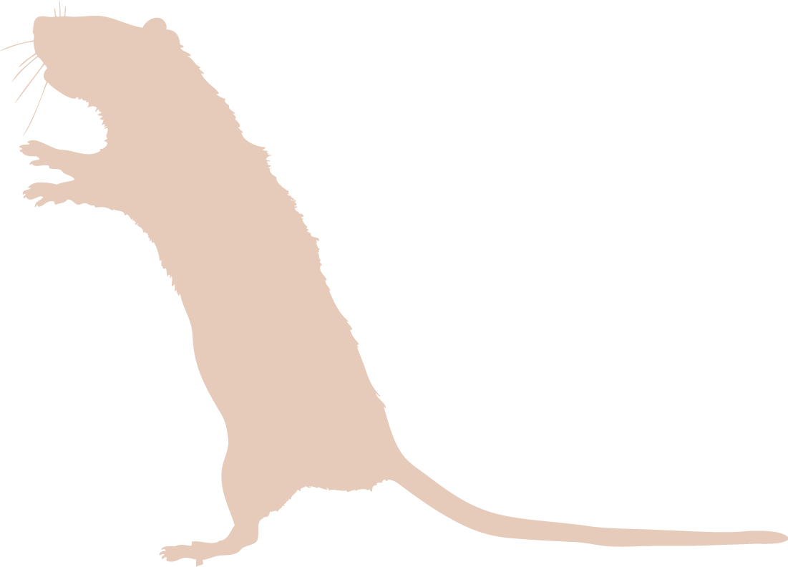




Who’s that introduced predator?
Can
YOU
help solve these mysteries?

Slide 2
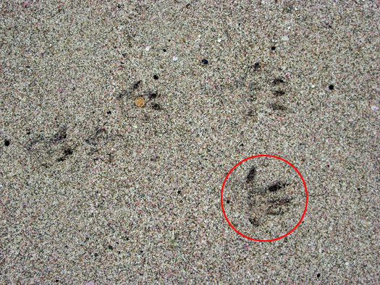
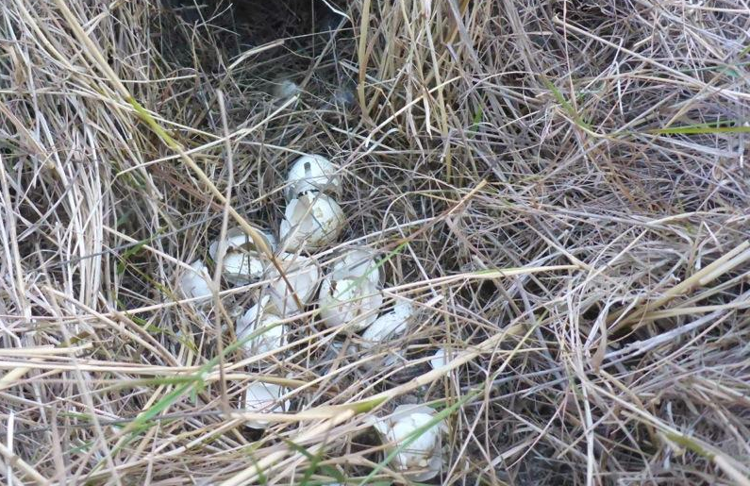
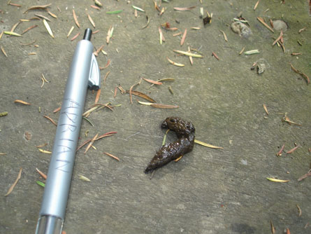
Introduced Predators: signs to look for
Droppings
Footprints or tracks
Burrows, hair or fur
Remains of other animals, their eggs or young
Damage to trees, plants, flowers, fruit, or seeds
Photo of droppings (above) by Jon Anda

Slide 3
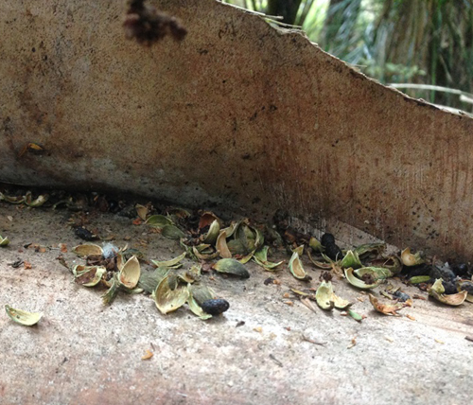
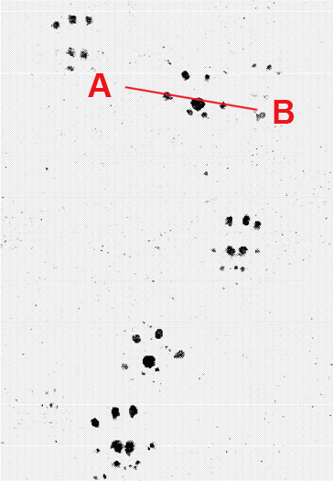
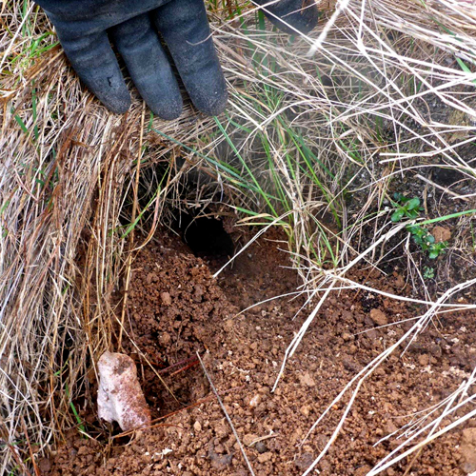
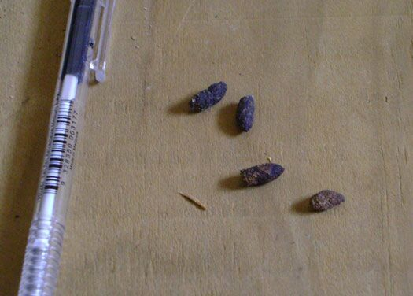
Case #1: Seed muncher
Who is this introduced predator?
Signs: This animal has eaten the seeds from a nikau palm (see top left photo).
Pieces of insects and eggs have also been found in the area around the burrow.
Footprints and droppings are shown on the right.
Sighting description: Animal with a thick, long tail seen in the area.
Above: Nikau seed damage (photo by Jamie MacKay)
Burrow close by (photo by Jon Anda)

Slide 4
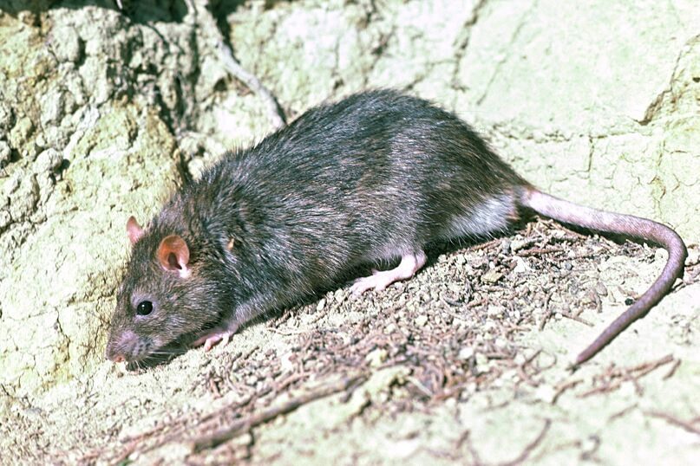
Case #1: It was a rat!
Norway rat in Otago Peninsula (Photo credit: DOC)

Slide 5
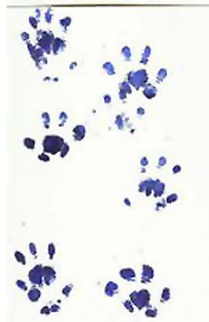
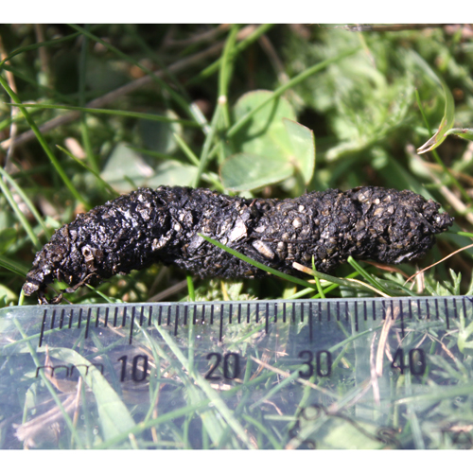
Case #2: A sneaky one
Who is this introduced predator?
Signs: Snuffling sounds have been heard at night. Lizards, frogs, invertebrates and eggs have been disappearing from the area.
Tracks and droppings detected are on the right. Droppings are filled with pieces of eggshells and insects.
Sighting description: Spiny backed animal with pointy snout.
Droppings found (photo by Astrid van Meeuwen-Dijkgraaf)

Slide 6
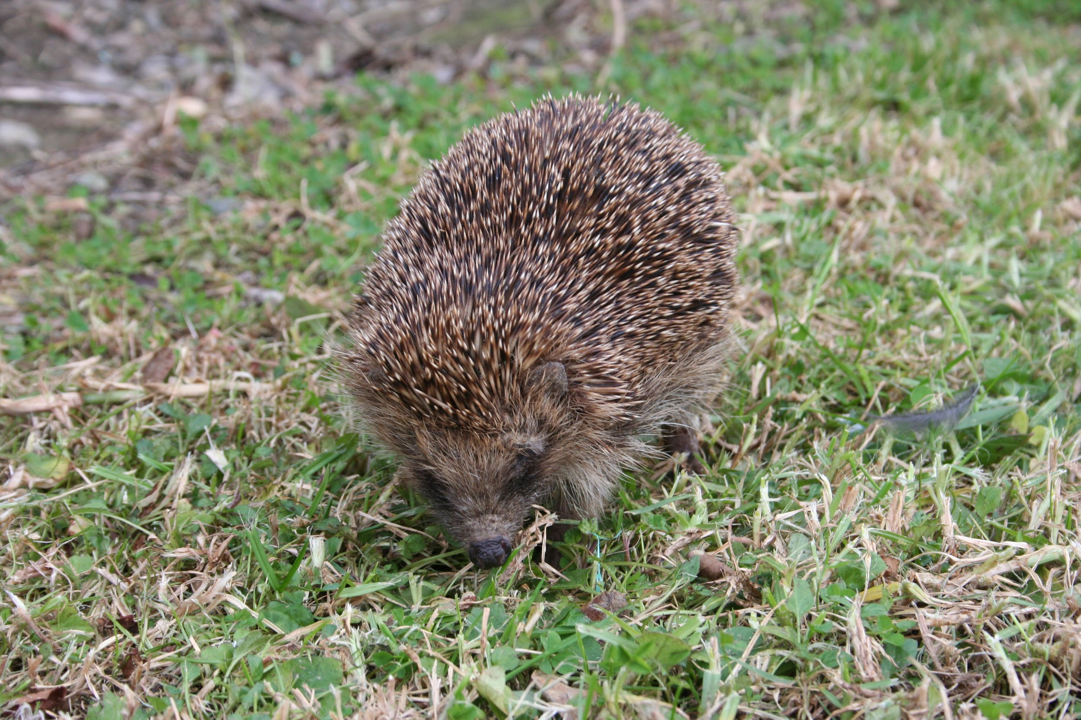
Case #2: It was a hedgehog!

Slide 7
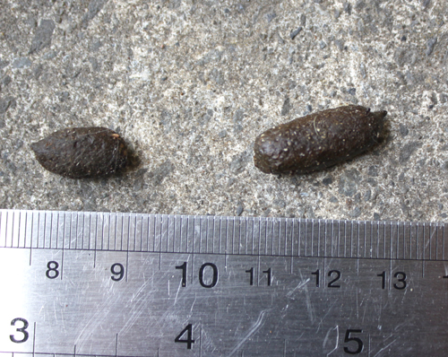
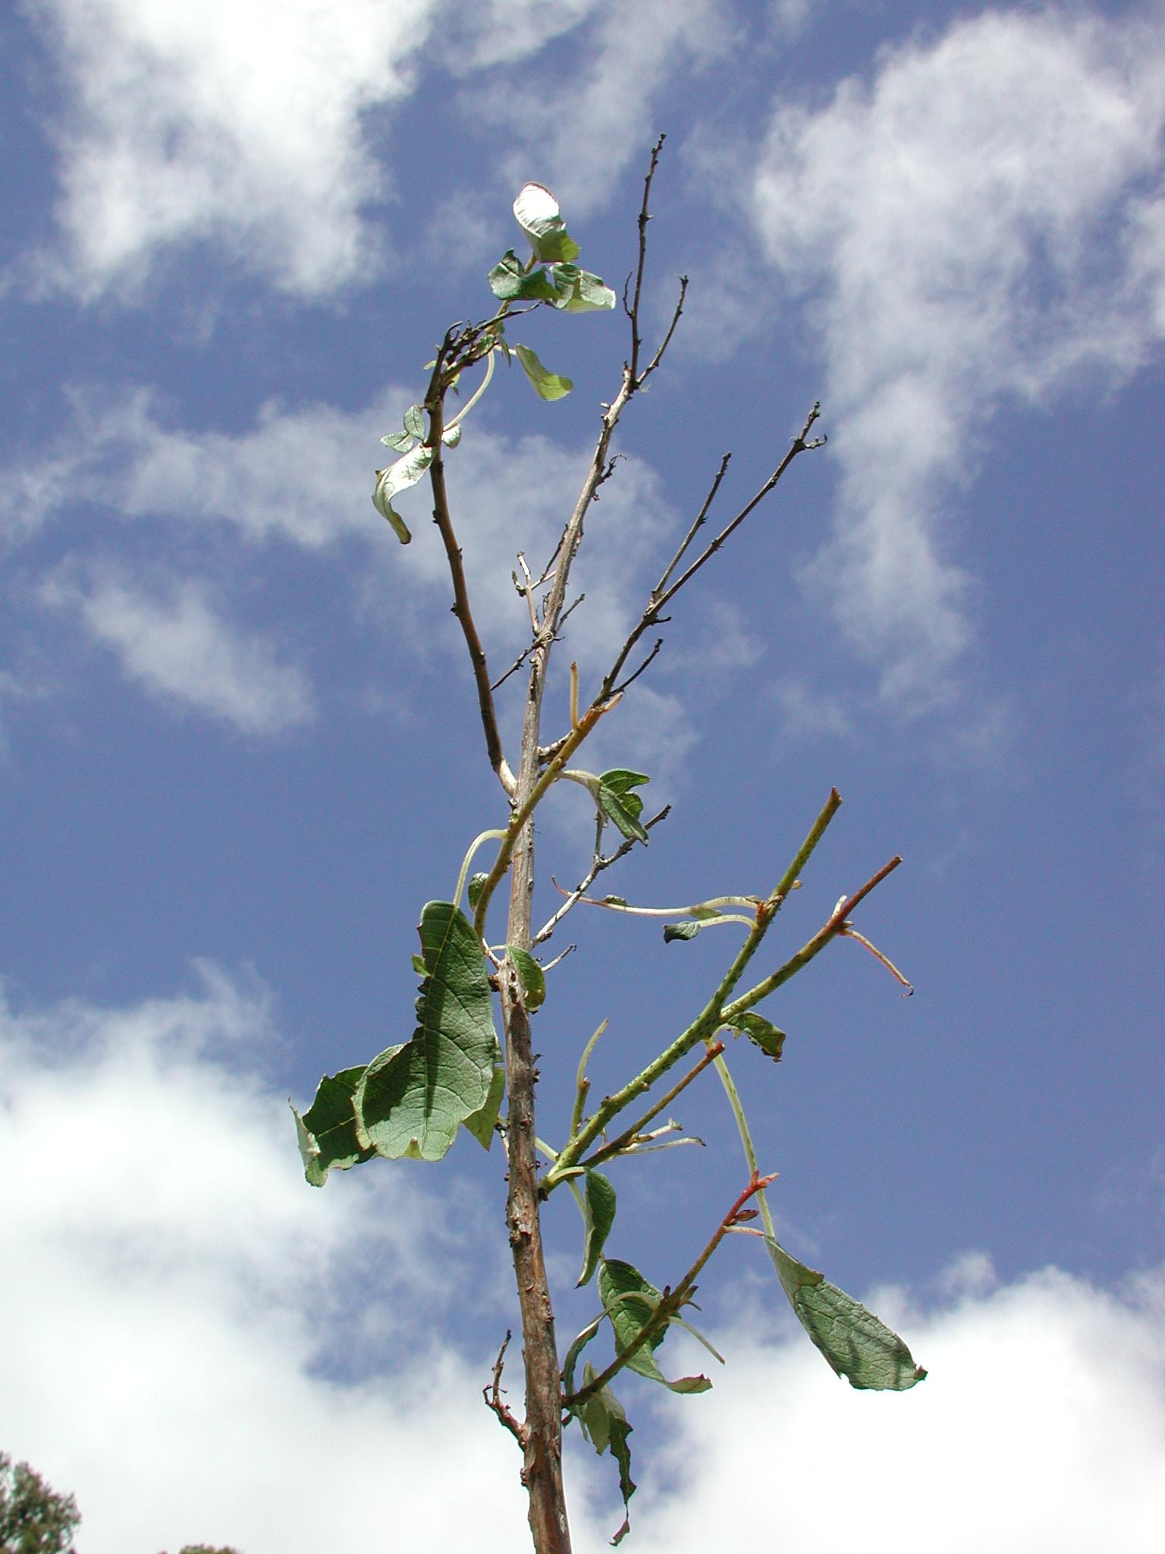
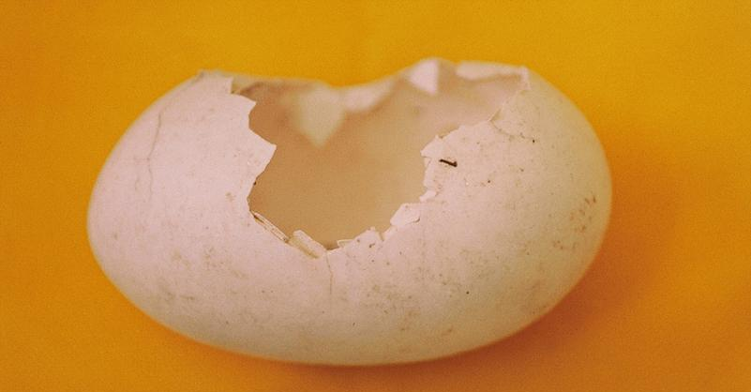
Case #3: Leaf thief
Who did this?
Signs: This animal has eaten the leaves and fronds from many native trees and ferns in a bush block. There are many branches being stripped of leaves each night.
Sighting description: Noises heard at night, fairly large animal seen.
Droppings found at scene (above). Photo by Astrid van Meeuwen-Dijkgraaf
Tree damage
Egg damage

Slide 8
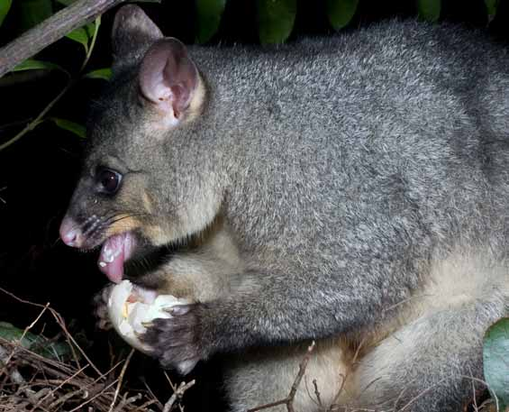
Case #3: It was a possum!
Possum eating bird egg (Photo credit: DOC)

Slide 9
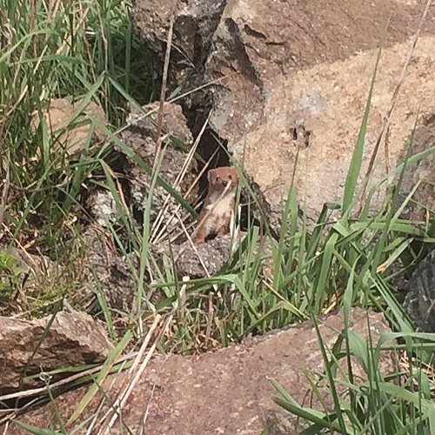
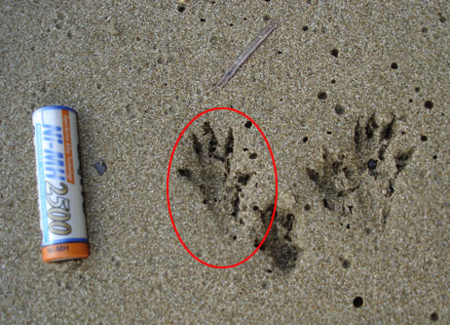
Case #4: On the hunt
Who is this introduced predator?
Signs: This animal has eaten many eggs, chicks and adult birds. Bite marks were seen on the necks of dead birds at the scene.
Sighting description: Very fast animal with black tip on tail.
Sighting of animal (photo by John Abel)
The tracks on left were found on a nearby beach, near destroyed eggs.

Slide 10
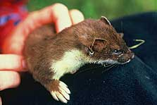
Case #4: It was a stoat!
Stoat (Photo credit: DOC)

Slide 11
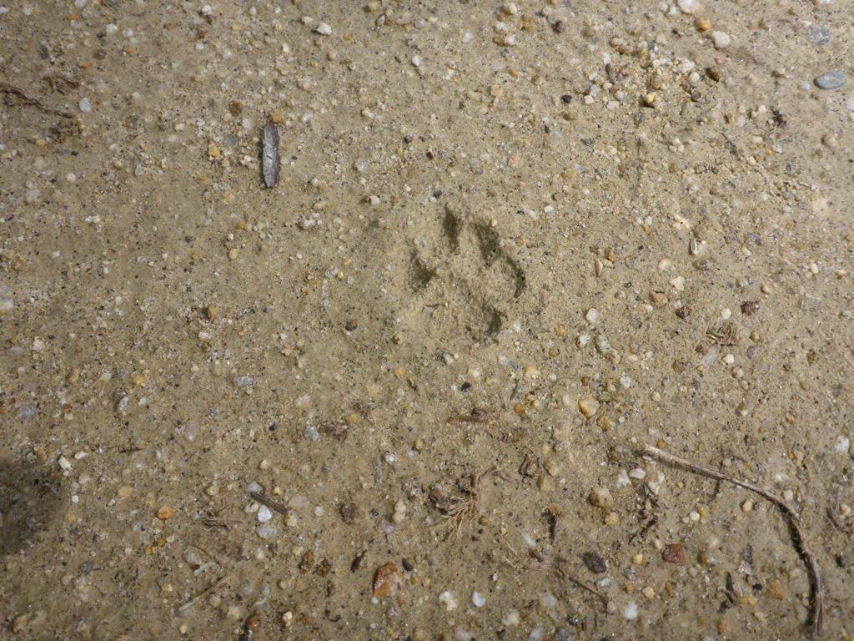
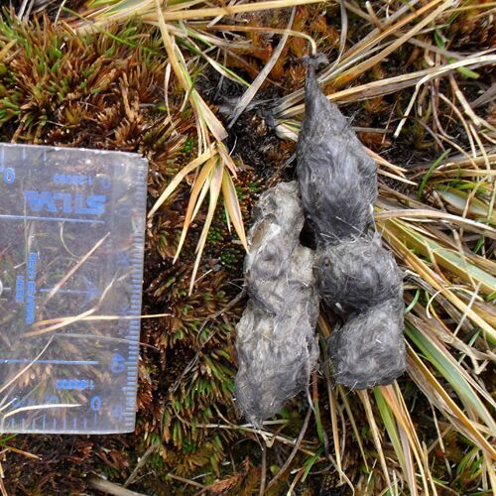
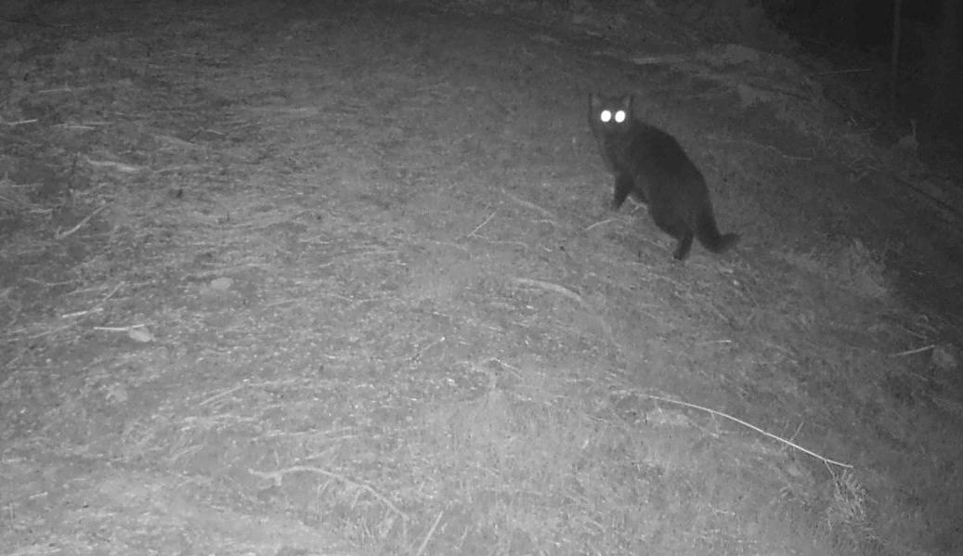
Case #5: Night predator
Who is this introduced predator?
Signs: Footprints were found from this animal (top right). Birds and chicks are going missing. Droppings shown below.
Sighting description: The animal has been seen spotted at night using video monitoring (bottom right).
Footprint (above) and night photo of animal (below). Both photos by Jon Anda.
Droppings found at scene
(Photo credit: DOC)

Slide 12
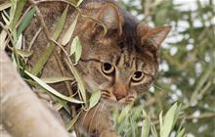
Case #5 It was a cat!
Hunting cat (Photo credit: DOC)

