Slide 1
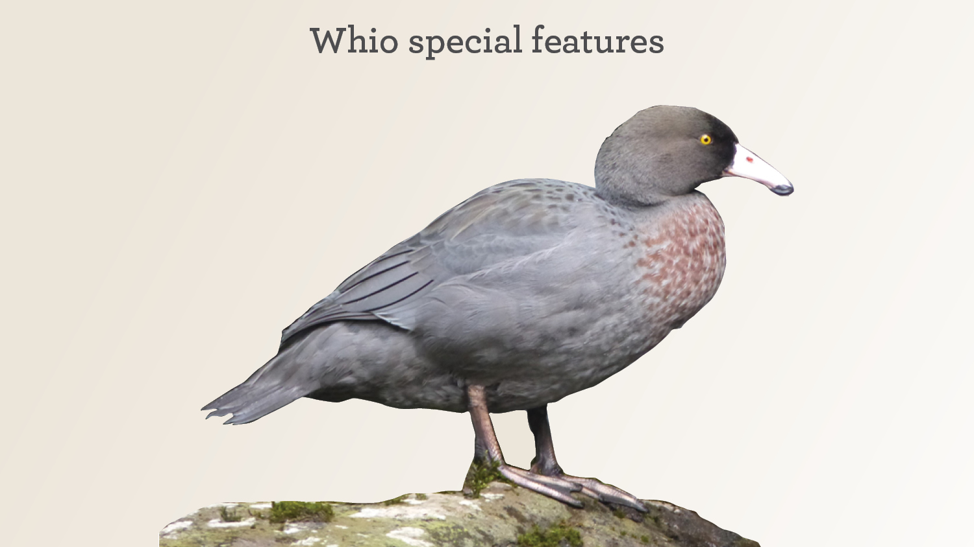
Photo: Bubs Smith
Notes:
Whio have many special features that make them suited to their habitat.

Slide 2
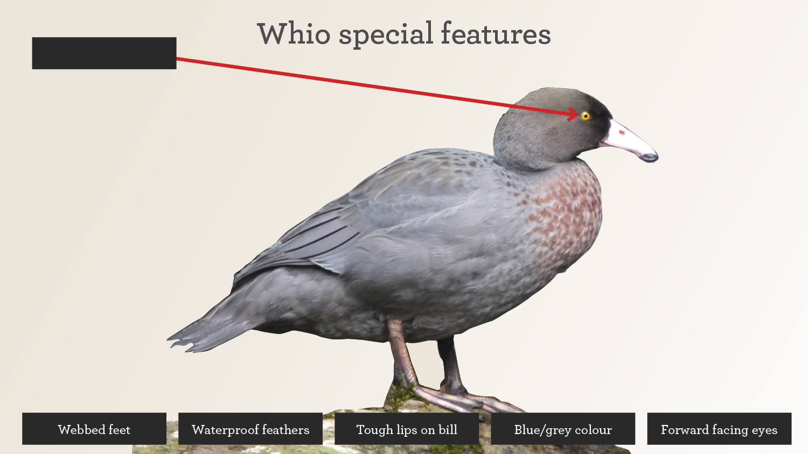

Slide 3


Slide 4
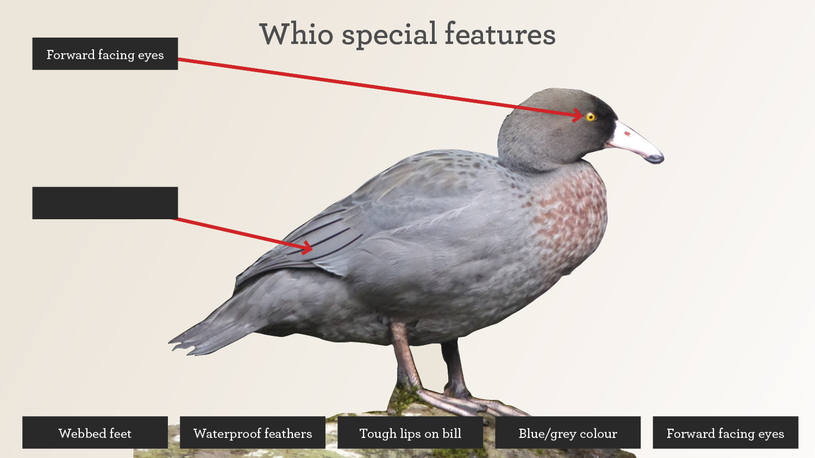

Slide 5
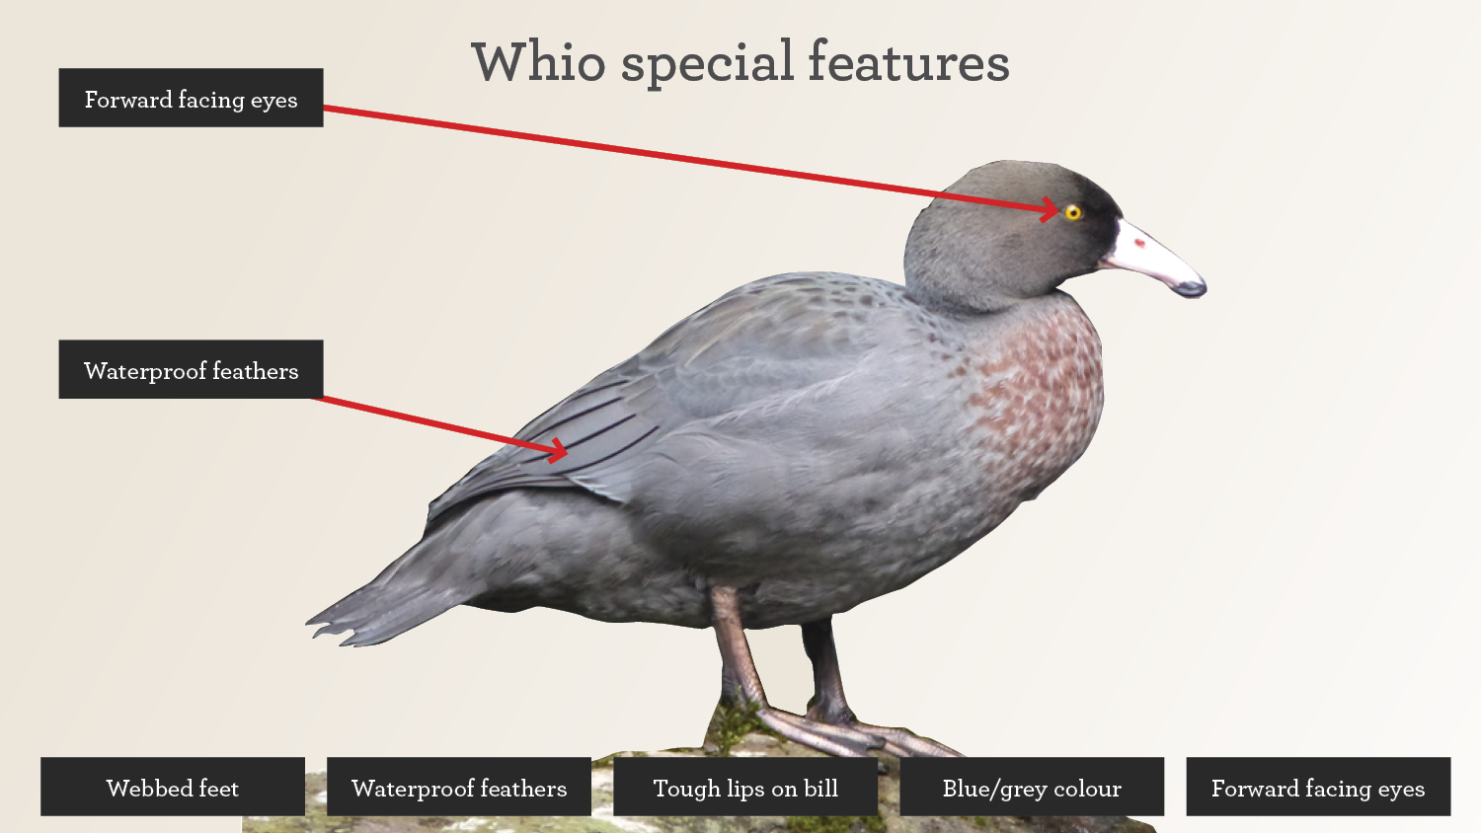

Slide 6
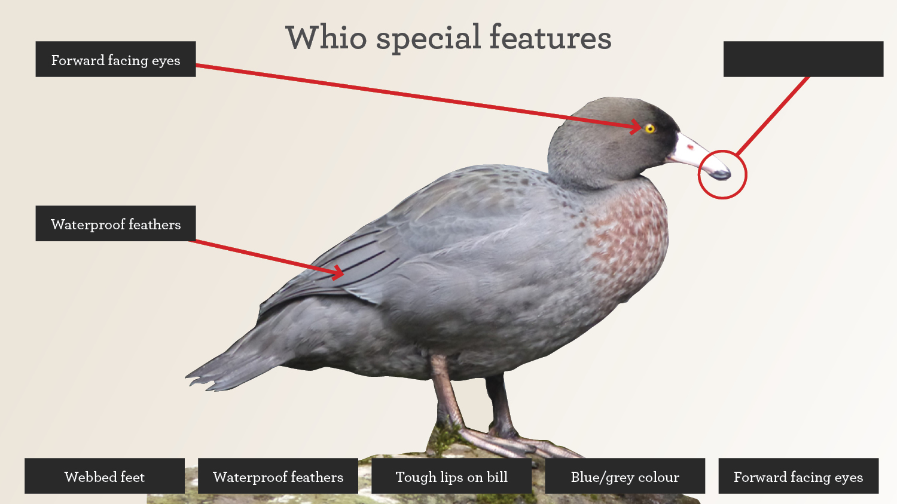

Slide 7


Slide 8
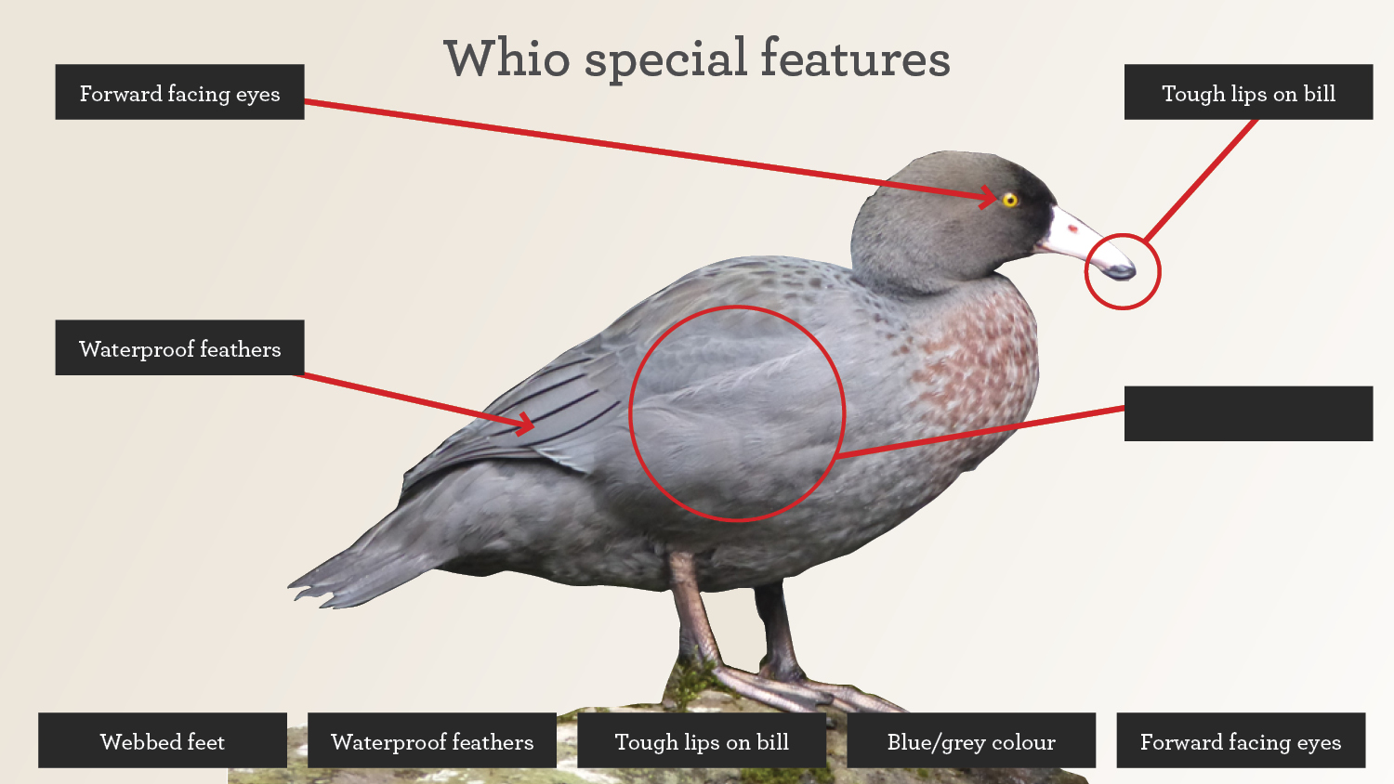

Slide 9


Slide 10
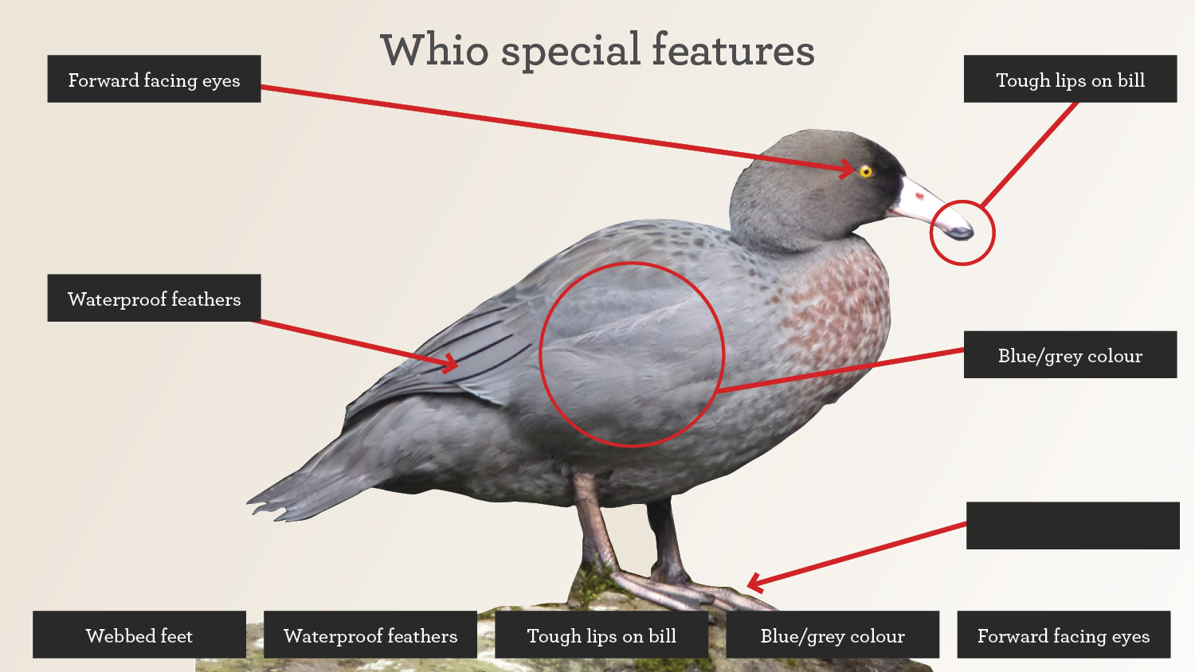

Slide 11


Slide 12
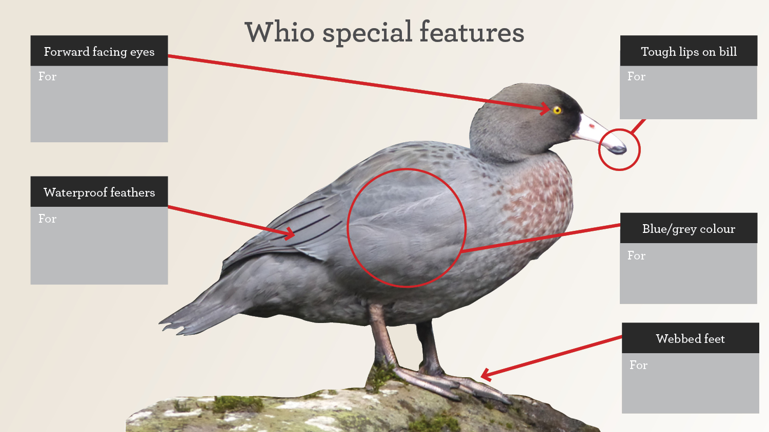

Slide 13
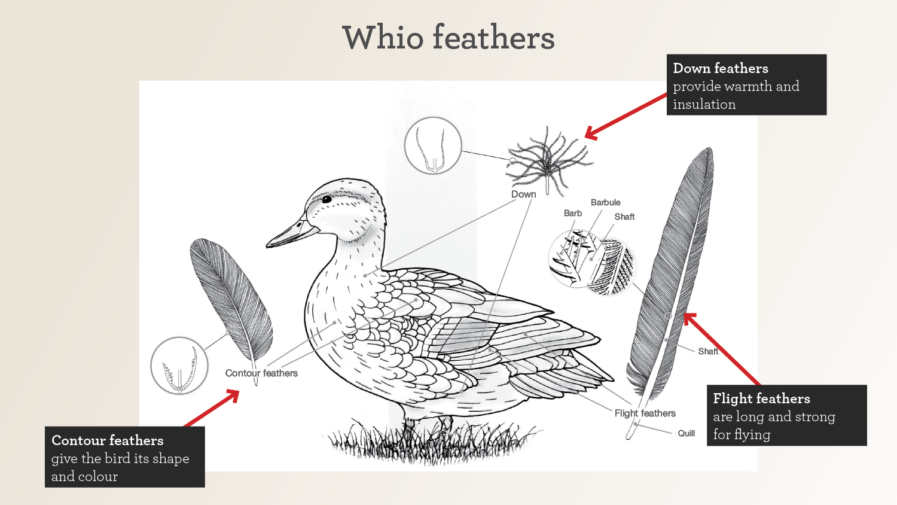
Diagram: Building Science Concepts 3: Bird: Structure, function and adaptation, published by the Ministry of Education, copyright © Crown, 2000

