Slide 1
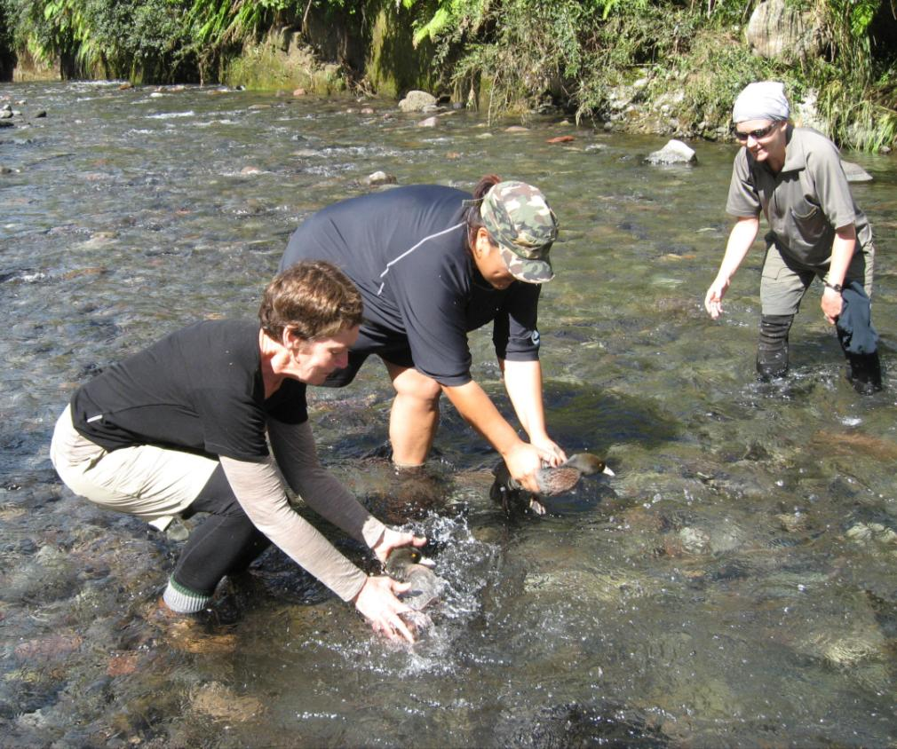
Whio and people
Notes:
http://blog.doc.govt.nz/2013/04/16/whio-egmont-national-park/

Slide 2
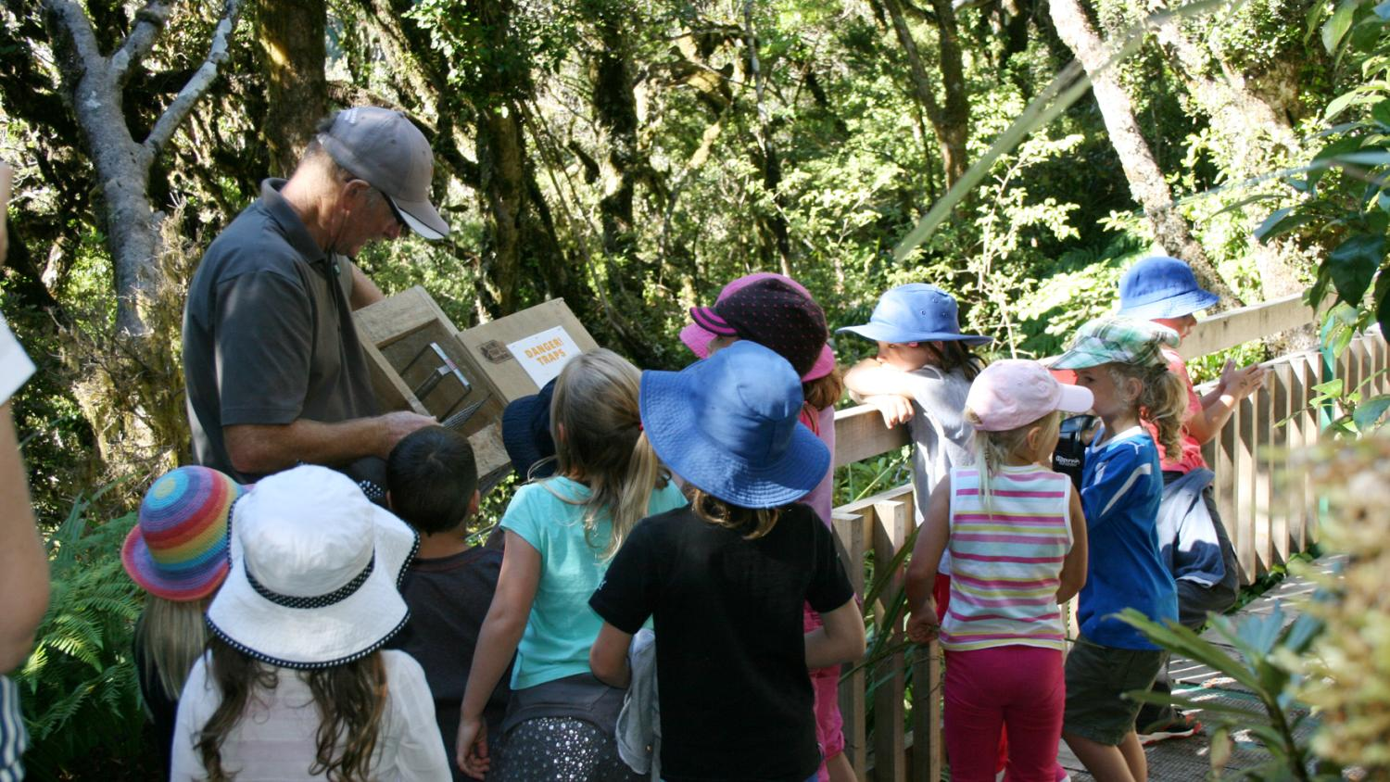
Notes:
Taranaki school and Ranger Mike showing them a stoat trap

Slide 3
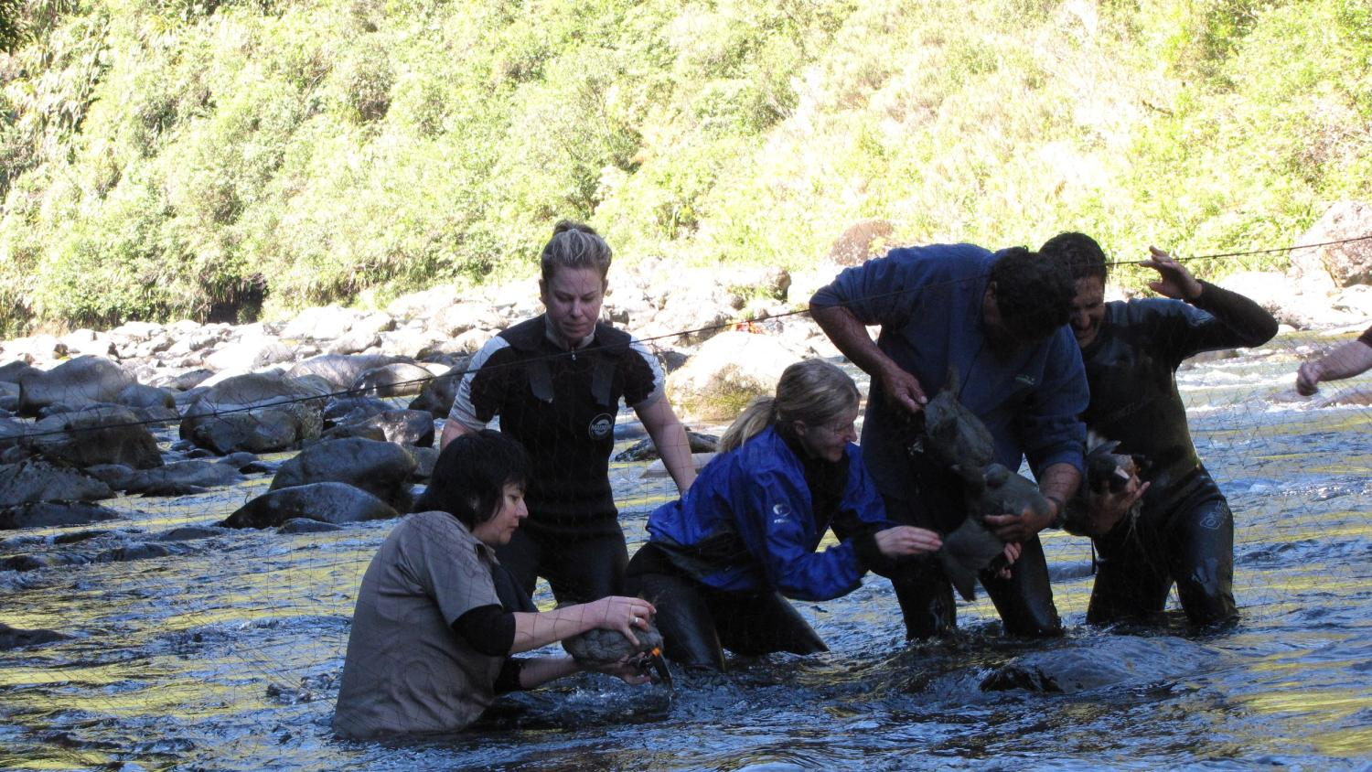
Photo: Bubs Smith
Notes:
DOC staff capturing whio to monitor

Slide 4
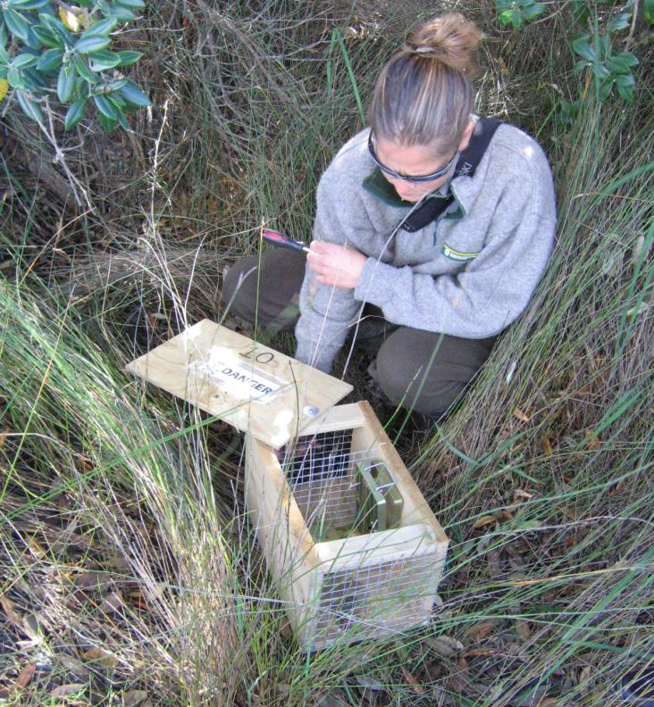

Slide 5
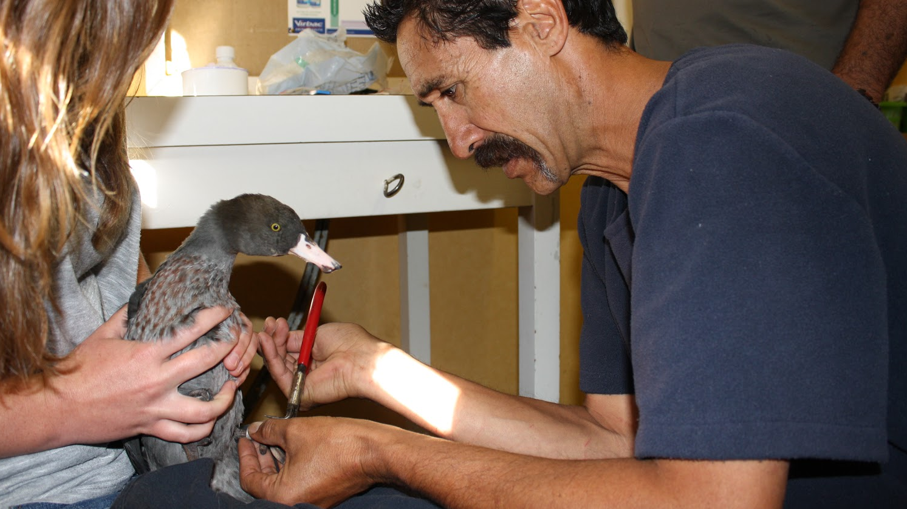
Notes:
Ranger Bubs Smith checks over a whio before its release.

Slide 6
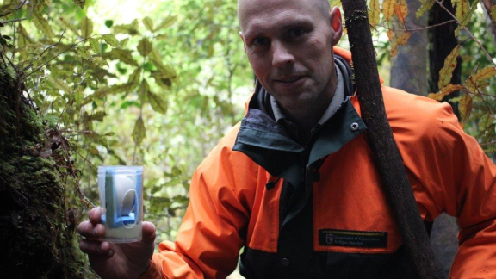

Slide 7
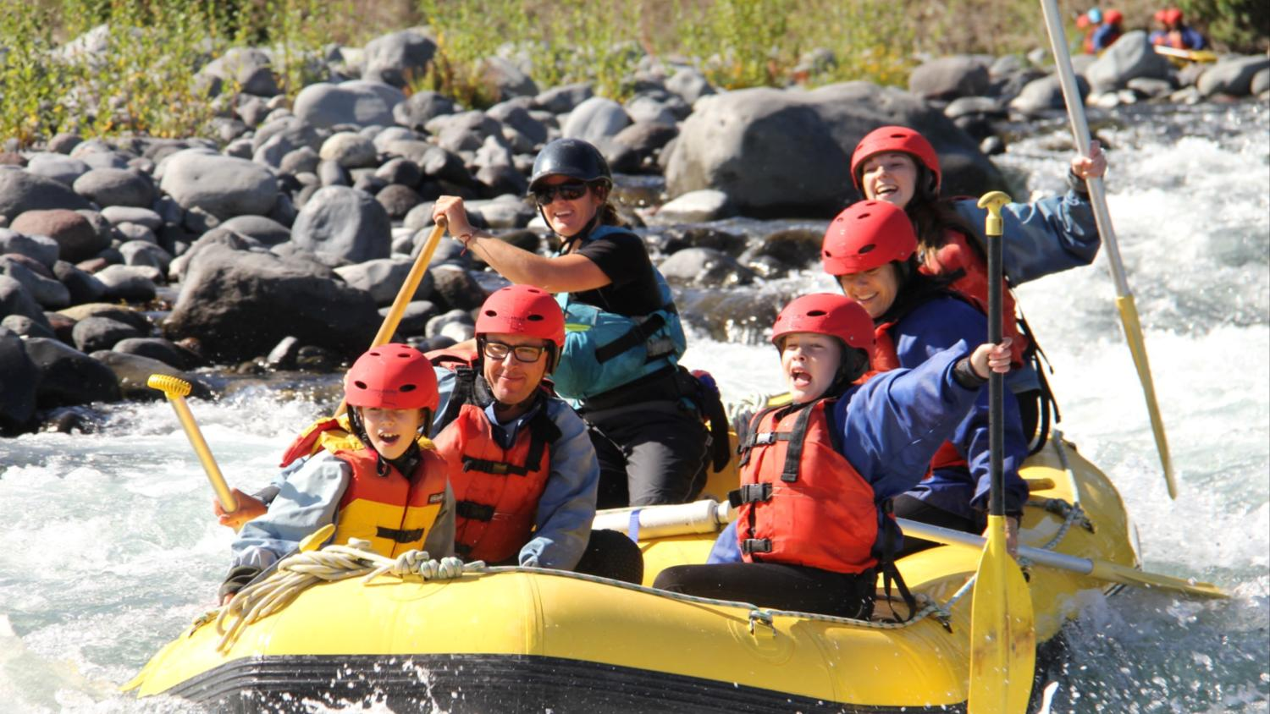
Photo: Tongariro River Rafting
Notes:
Tongariro River Rafting inflatable down Tongariro River- a habitat of whio

Slide 8
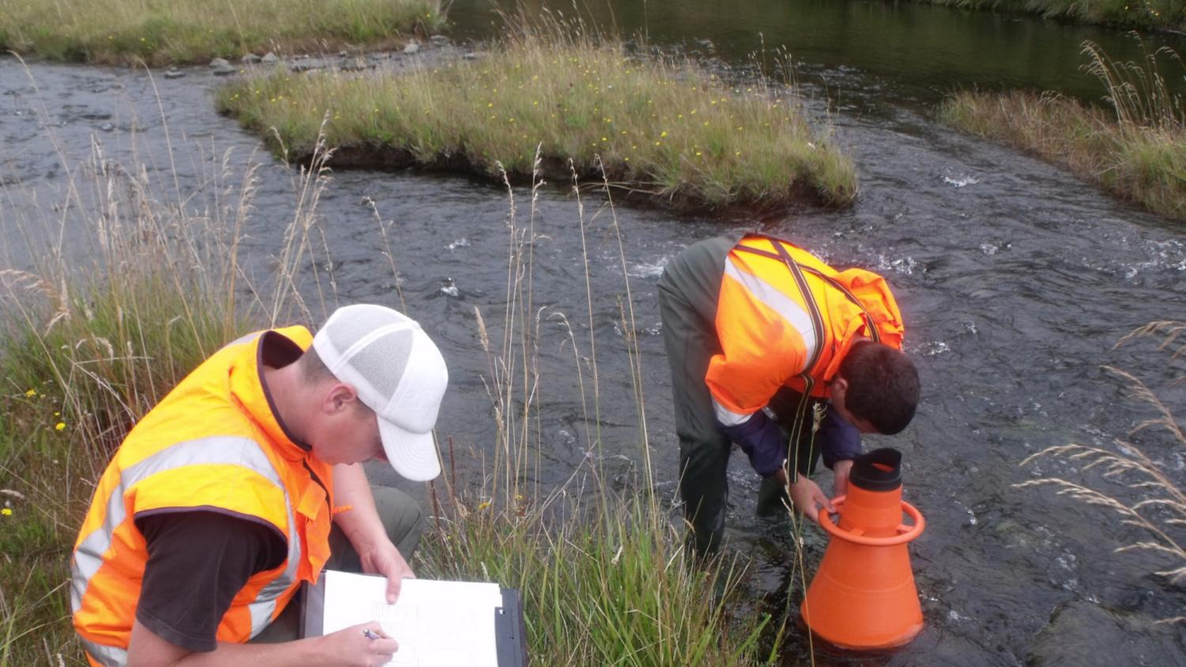
Photo: Cam Speedy
Notes:
Tonkin and Taylor experts checking the health of the stream for Genesis Energy

Slide 9
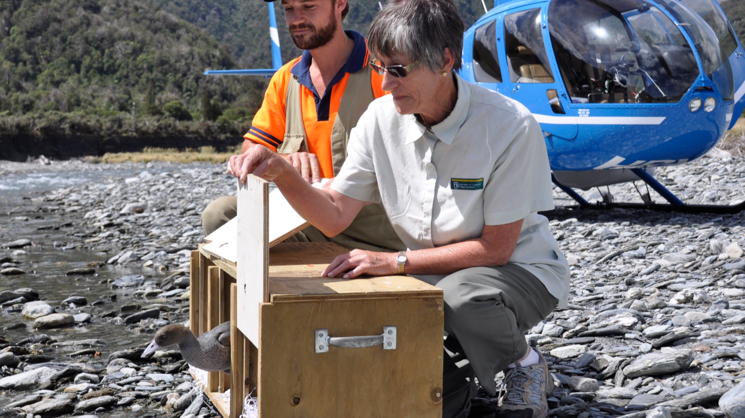
Notes:
Whio released back into wild

Slide 10
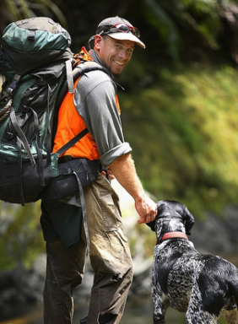
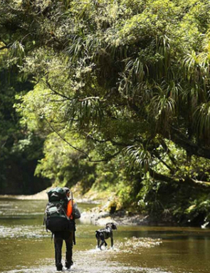
Photos: Rob Suisted
Notes:
Andy Glaser and Neo and whio dog looking for whio at Te Urewera National Park

Slide 11
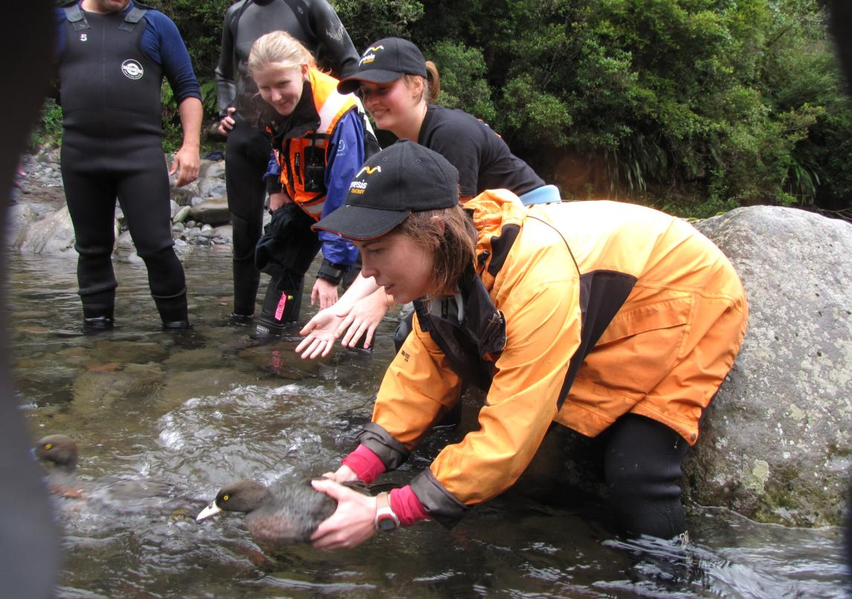
Photo: Genesis Energy

Slide 12
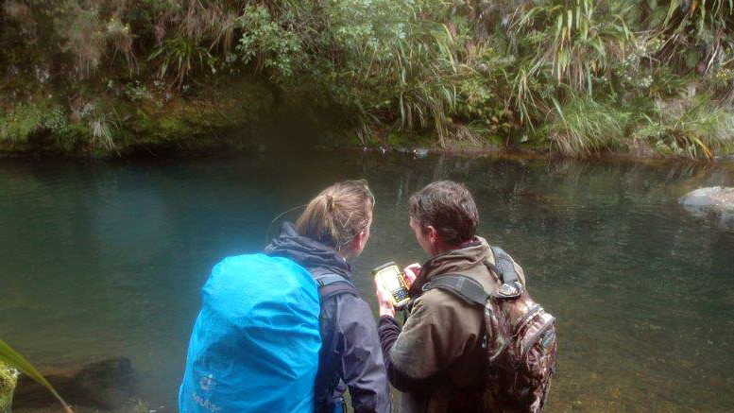
Notes:
Community group monitoring whio - recording location

Slide 13
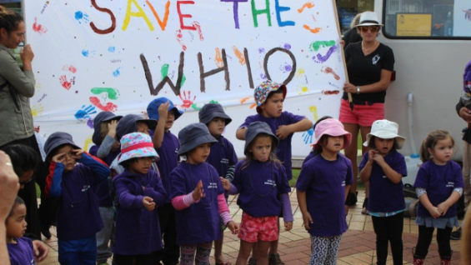
Photo: Hāpaitia Kōhanga
Notes:
Hāpaitia Kōhanga performing a fundraiser kapa haka performance, with money raised going towards whio protection in the Ōroua Valley.

